Slide 1
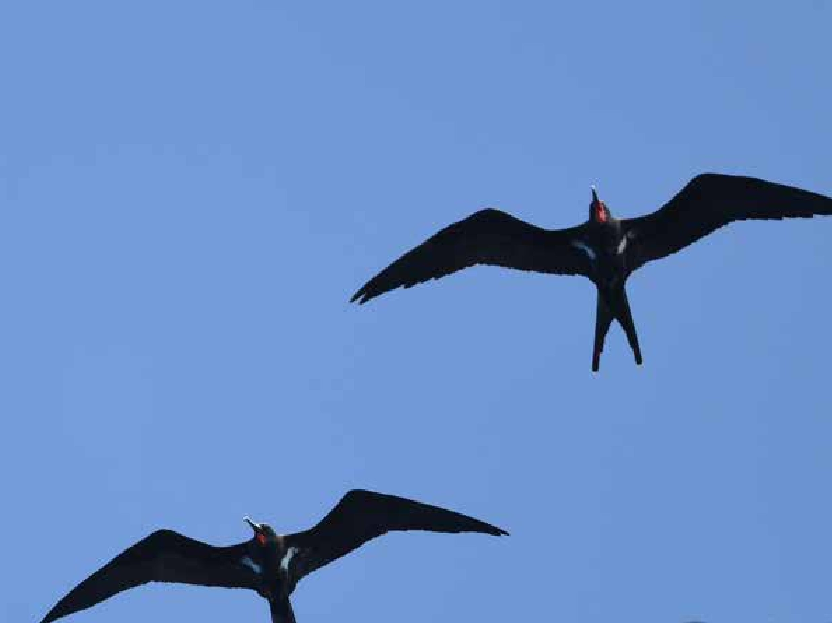
Palau Seabird Survey & Monitoring Workshop
Koror, 26-30 October 2026
Ray Pierce, Eco Oceania
Monica Gruber, Pacific Biosecurity
Etienne Delattre, SPREP
Notes:
Cover slide image: Lesser Frigatebirds, Kiribati. Hiroyuki Tanoi
This is the first slide for each day

Slide 2


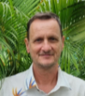
Introductions
Ray Pierce, EcoOceania
Monica Gruber, Pacific Biosecurity
Etienne Delattre, SPREP

Slide 3
Objectives of the workshop
Familiarization with
  Seabird biology, ecology and threats
  Seabirds in Palau
Understanding of basic survey methods on-land and at-sea
Practical surveying on-land and at-sea
Managing seabird data for Palau
Notes:
The objectives of the three-day workshop to familiarize participants with
Seabird biology, ecology and threats
Basic survey methods on-land and at-sea
Practical surveying on-land and at-sea
Managing data related to seabirds in Palau

Slide 4
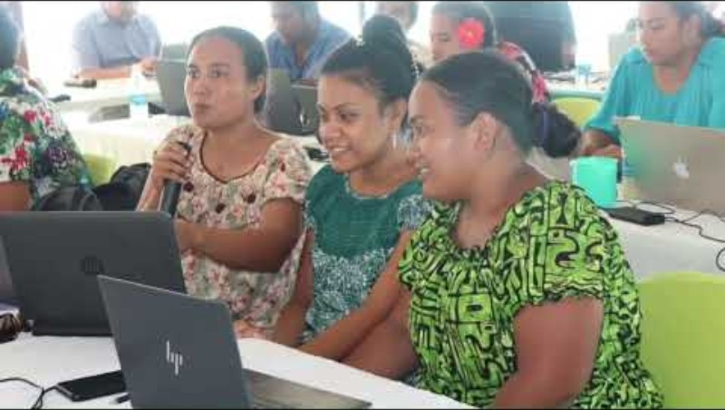
The Pacific BioScapes programme
Notes:
A short Youtube video that introduces the programme
https://www.youtube.com/watch?v=AU4hkzhE6PA&t=4s

Slide 5

The Palau seabird monitoring project
Objective
Deliver seabird monitoring training in Palau to government agencies, NGOs, CSOs, and tourism operators who are either
  working on seabirds or
  have field capacity and interest
Contributes to Pacific BioScapes’ Activity 2.1.5: Increase site level management capacity of Palau’s Protected Areas Network
Notes:
The Palau seabird monitoring project is part of the Pacific BioScapes programme.
The project purpose is to deliver a seabird monitoring training in Palau for government agencies and NGOs, CSOs and tourism operators which are either working on seabirds or have field capacity and interest to do so.
The project contributes to the implementation of Pacific BioScapes’ Activity 2.1.5: Increase site level management capacity of Palau’s Protected Areas Network (PAN).

Slide 6
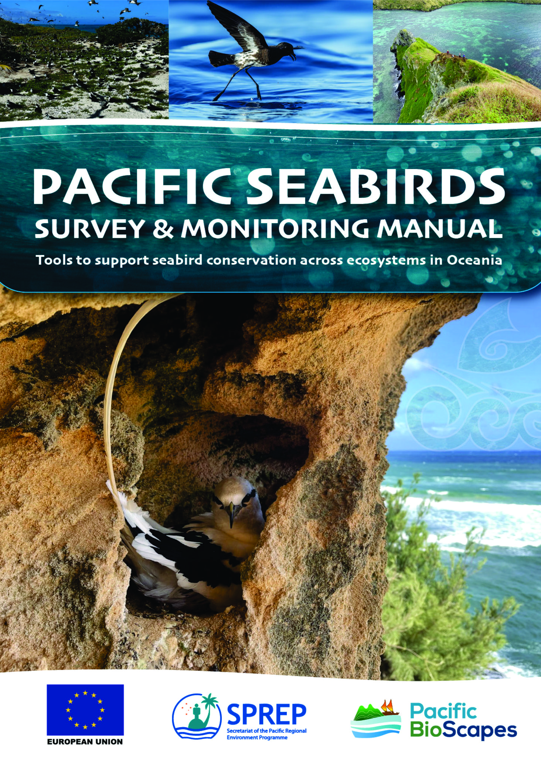
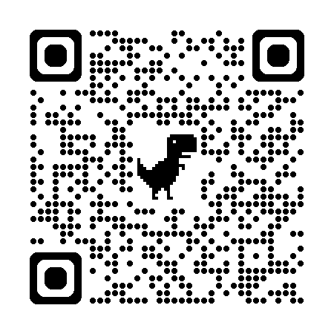
Pacific Seabirds Survey and Monitoring Manual
SPREP website https://seabirds.pacificbiosecurity.co.nz/uploads/Pacific-seabird-manual.pdf
Website for this workshop https://seabirds.pacificbiosecurity.co.nz/
Notes:
Many of the resources that support the workshop this week are derived from the Pacific Seabirds Survey and Monitoring Manual, which was developed by SPREP for anyone in the region to use.
These are links to the pdf of the manual on the SPREP website, and the website developed for this workshop.
We will use the website for much of today’s workshop. You can scan the QR code on your phone or type in the website address.
If you want to browse sections of the Manual as we talk through them you can use the website on your phone or laptop.
[skip to website] https://seabirds.pacificbiosecurity.co.nz/
The manual has five parts, as outlined in the webpage heading:
An introduction to seabirds of the Pacific;
An introduction to different types of tools for surveying;
Measurement metrics for monitoring
Managing data to support conservation
And links to some additional some resources.
There is also a link to Palau workshop resources (which has the presentations and other resources to support training in Palau), and an Acknowledgments section.
All sections that are numbered are found in the Manual itself, and sections that don’t have numbers are those that we have created for the workshop.
For example, in Part 1 we have added a section on Seabirds of Palau, specially for this workshop.
Slide 6: PSSMM cover (see cover images on the Acknowledgements slide)

Slide 7
Overview of the three-day workshop
Day 1 covers Parts 1-3 of the Pacific Seabirds Surveying and Monitoring Manual
  Part 1: Introduction to seabirds
  Part 2: Survey tools & types
  Part 3: Measurement & monitoring
Day 2 is a practical day to practice identifying seabirds and using survey tools
Day 3 is intended to review the practical work and covers the last two parts of the Manual
  Part 4: Managing data
  Part 5: Resources
Notes:
The workshop covers all parts of the Manual at a high level.
Day 1 covers Parts 1-3 which includes
an Introduction to seabirds
Survey tools & types and
Measurement & monitoring
Day 2 is a practical day to practice identifying seabirds and using survey tools
Day 3 is intended to review the practical work and covers the last two parts of the Manual
Managing data and
Resources

Slide 8

Mentimeter
Mentimeter is a way for people to share their views anonymously
We won’t know what your answers are, we only see the group results
We use Mentimeter to do some spot quizzes throughout the workshop
Let’s try it out…
Use your phone to scan this QR code
Notes:
Mentimeter is a way for people to share their views anonymously
We won’t know what your answers are, we only see the group results
We use Mentimeter to do some spot quizzes throughout the workshop
Let’s try it out…
Use your phone to scan this QR code
If you don’t have a smartphone you can share with other people

Slide 9
Mentimeter
What is your name?
What organization do you work for?
Have you surveyed seabirds before?
Have you surveyed other birds before?
What do you want to learn in this workshop?

Slide 10

1) Parking lot
When you think of something you want to know more about, or have a question, write it on a post it note and stick it to the parking lot wall
We can discuss the notes after each break

Slide 11
Day 1: Introduction to seabirds and seabird monitoring
Ray Pierce and Monica Gruber
Notes:
Monica

Slide 12
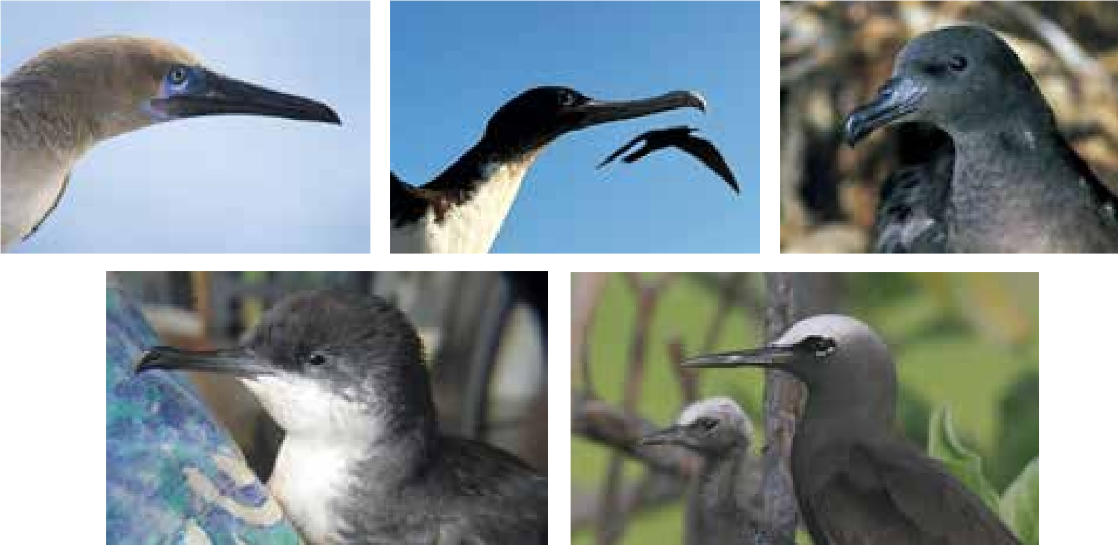
Today’s topics
  Part 1: Introduction to seabirds & monitoring
  Part 2: Survey tools & types
  Part 3: Measurement & monitoring
Notes:
Today we will cover the first three parts of the Manual, which provide the relevant background for the practical work tomorrow.
Part 1 is an introduction to seabirds, their ecology and why we would want to monitor them.
We’ll cover the important role seabirds play in the environment, some general information about their biology and ecology – how they live, and the threats they face.
There will be an introduction to the seabirds that live in the Pacific region broadly and in Palau
Part 2 discusses the tools that are used to survey seabirds
We’ll talk about the value of surveys of communities and how to assess threats to seabird populations.
Finally, there will be a discission of how to survey seabirds on the land and at-sea
Part 3 discusses how to measure and monitor key indicators for seabird populations.
This includes monitoring of nests and assessing their reproductive success.
Most of this material will be covered by Ray as he is the seabird expert.
Slide 12: PSSMM Figure 7

Slide 13
Part 1: Introduction to seabirds
1.1 Seabirds
1.2 Why survey and monitor seabirds
1.3 Seabird-driven ecosystems
1.4 Seabirds of Oceania
Seabirds of Palau - identifications
1.5 Traditional knowledge and customs
1.6 Threats
1.7 Developing a survey & monitoring programme
1.8 Working with communities
Notes:
Our first topic is Part 1 of the Manual.
This has eight sections, and the sections we will cover are in bold text
As Palau already has a bird monitoring programme run through the Belau National Museum we won’t discuss developing a surveying and monitoring programme, but we will discuss what might be added to that programme for seabird monitoring.
We also won’t discuss traditional knowledge as you know this far better than we could.
Similarly, we will only briefly discuss working with communities, as you already know this, but we will talk about the value that community knowledge can bring to seabird monitoring.
…

Slide 14
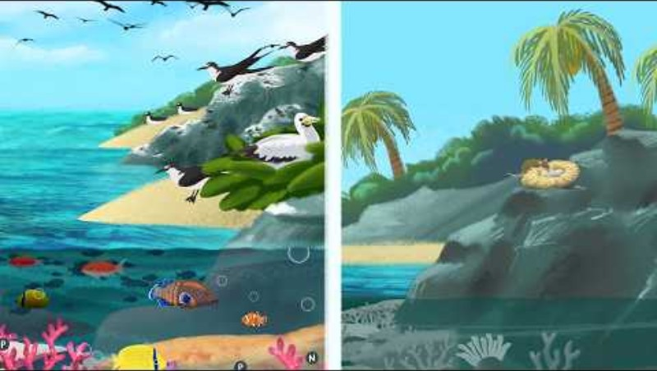
The importance of seabirds
Notes:
I’m going to let this video tell part of the story of why seabirds are important to ecosystems.
Although this talks about invasive species impacts, it demonstrates that key role that seabirds play and why keeping their populations healthy is important.
Slide 14: video produced by Mair Perkins Ltd. Animation & Illustration and commissioned by Lancaster University: https://www.youtube.com/watch?v=kwd73dK8f1A

Slide 15
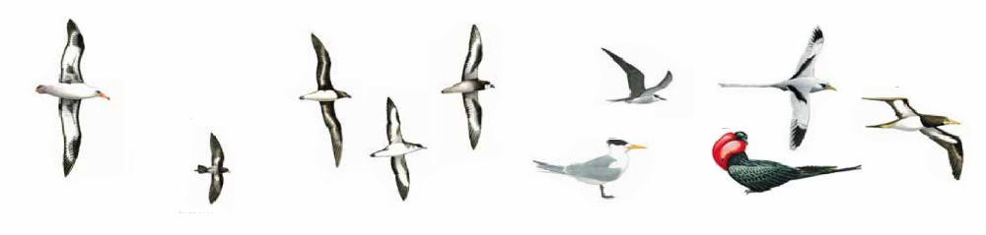
What are seabirds?
Only 3% of birds are seabirds
They spend most of their lives in the marine environment but nest and breed on land
There are seven or eight different groups of seabird, and most of them are found in Palau
Albatrosses
Petrels &
shearwaters
Tropicbirds
“Procellariids”
Terns & noddies
Boobies
Storm-petrels
Frigatebirds
Notes:
Seabirds spend much of their lives at sea, although all of them nest on land.
There are seven or eight different groups of seabird, and most of them are found in Palau.
You’ll hear us talk about Procellariids, quite a lot. These are the grouping of albatrosses, petrels, shearwaters and storm petrels.
Ray will talk more about these, and I’ll hand over to him now.
Slide 15: PSSMM Figure 2

Slide 16
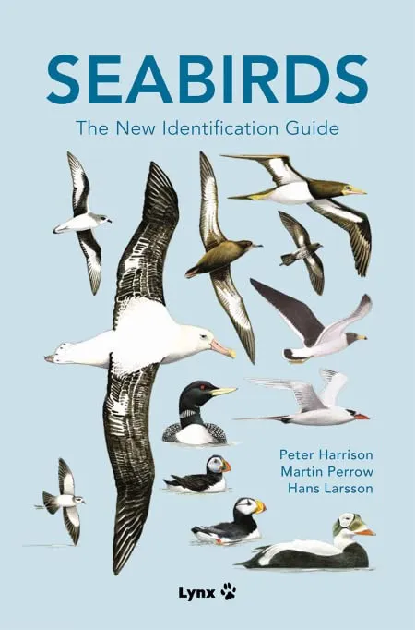
Seabird ecology 1. Morphological* adaptations
* morphological = body form
Seabirds are adapted for ocean life
  Waterproofed feathers
  Streamlined bodies
  Salt glands**
  Good eyesight
Notes:
Seabirds are adapted in different ways morphologically (in their form) for ocean life:
- waterproofed feathers, oil glands at base of tail
- streamlined bodies and legs set far back
- some (albatrosses, procellariids) have salt glands for excreting excess salt
- good eyesight for locking in on prey
Slide 16: Cover image from Seabirds: The New Identification Guide, by Peter Harrison, Martin Perrow, and Hans Larsson

Slide 17
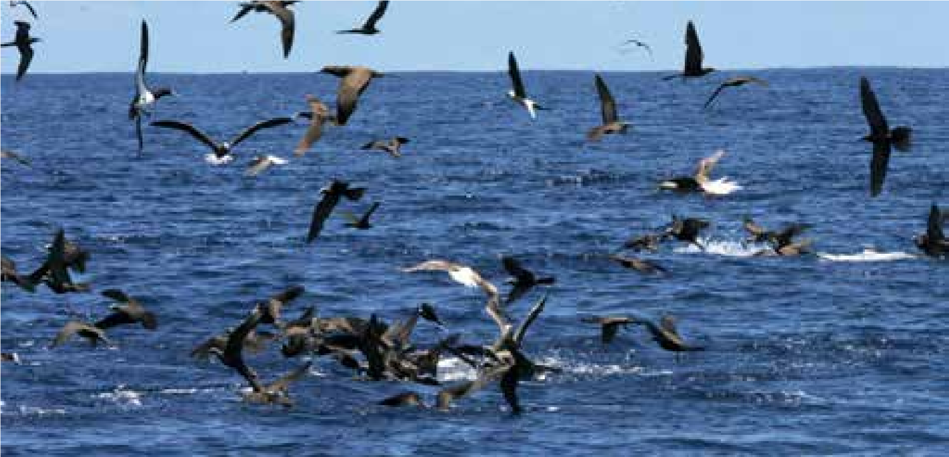
Seabird ecology 2. Feeding
Feed at sea on zooplankton*, fish or squid
They usually surface-dip or plunge-dive
Most come ashore at night
Sensitive to changes in ocean food supplies
* zooplankton = tiny animals that float in the sea
Brown and Red-footed Boobies and Brown Noddies at sea
Notes:
Seabirds spend all of their foraging time at sea, often dispersing or migrating long distances
Prey ranges from tiny zooplankton to large fish and squid
Prey is captured mainly by surface-dipping or plunge-diving
Most come ashore at night, c.f. Sooty Tern and Procellariids, and all come ashore to breed
Sensitive to changes in ocean food supplies, e.g. El Nino, climate change issues, overfishing.
Slide 17: PSSMM Figure 9. Foraging Brown and Red-footed Boobies, and Brown Noddies at sea, Samoa. Photo: Juney Ward, SPREP

Slide 18
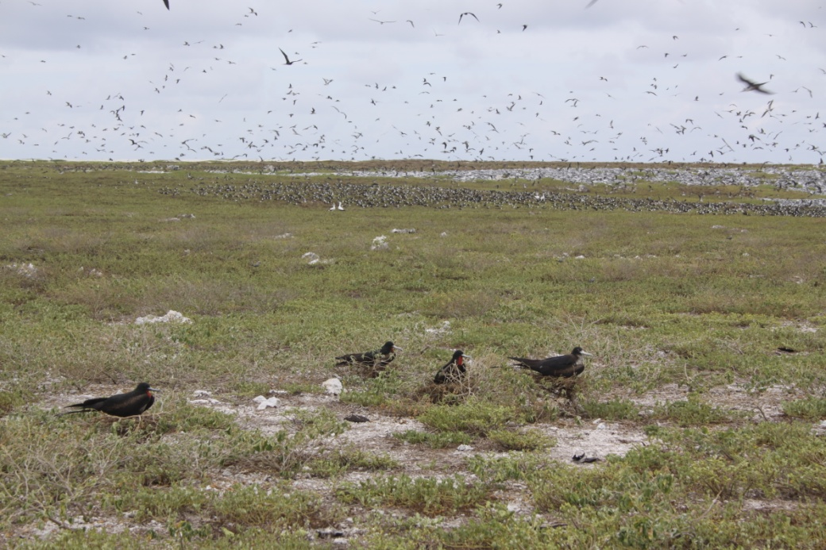
Seabird ecology 3. Nesting
Solitary or colonial nesters*, on ground or underground, to in trees, lay 1-2 eggs and are slow breeders and sensitive to changes on-land
* colonial nesters = nest in large groups
Notes:
They have a great variety of nesting strategies from solitary (name examples) to clustered and colonial
And ground-nesting, burrow-nesting to tree-nesting
And substantial nest construction to no formed nest
All lay 1-2 eggs seasonally or not, long incubation and fledging periods, i.e., slow breeders.
All sensitive to changes in on-land e.g. activities e.g. invasive species, habitat loss, disturbance, and so populations easily wiped out. On the other hand, they can recolonise in sites where these problems have been removed.
Slide 18: Ray Pierce

Slide 19
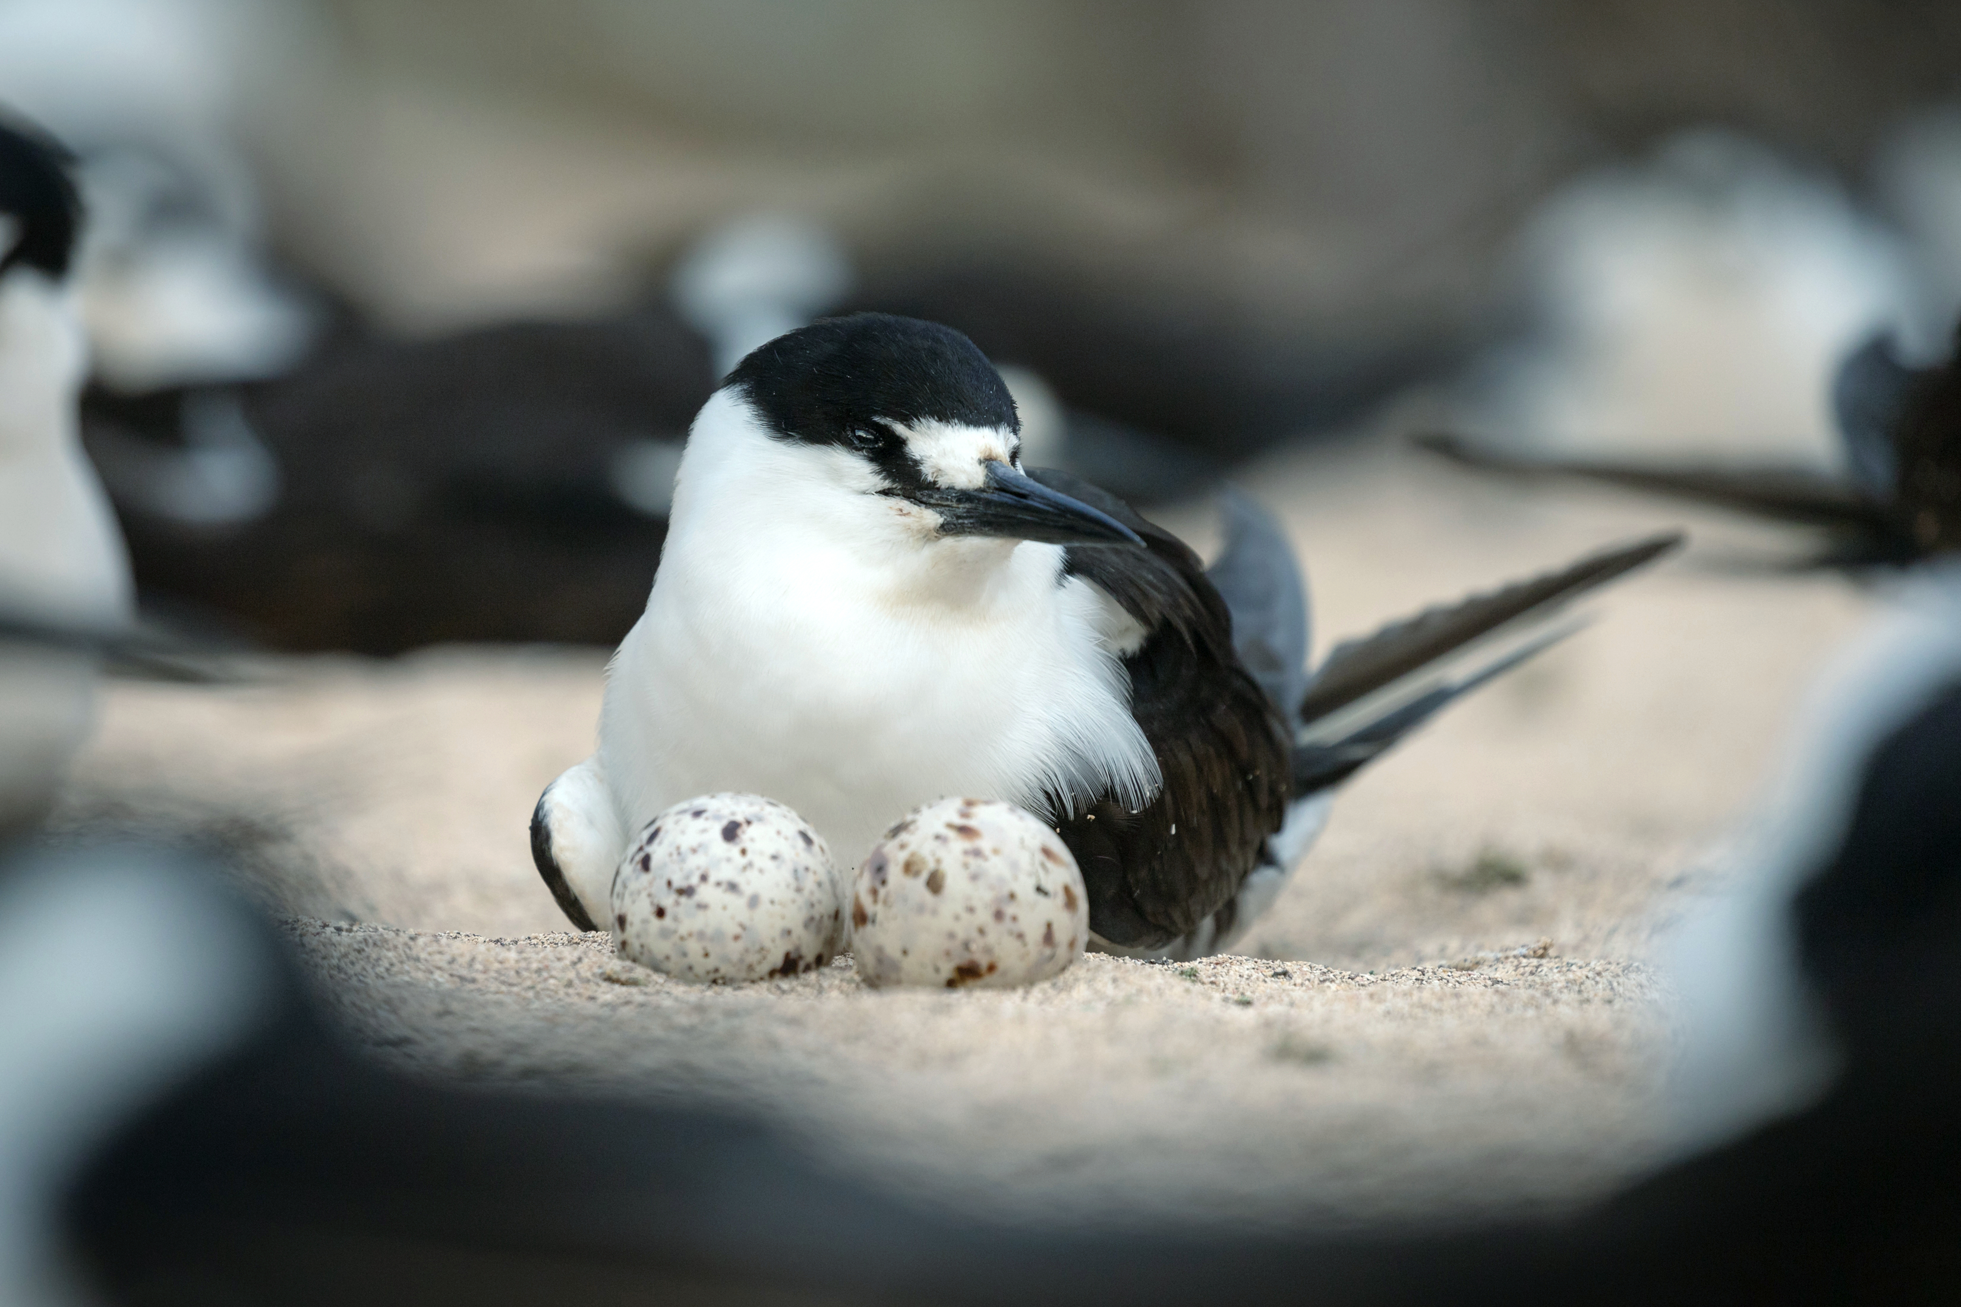
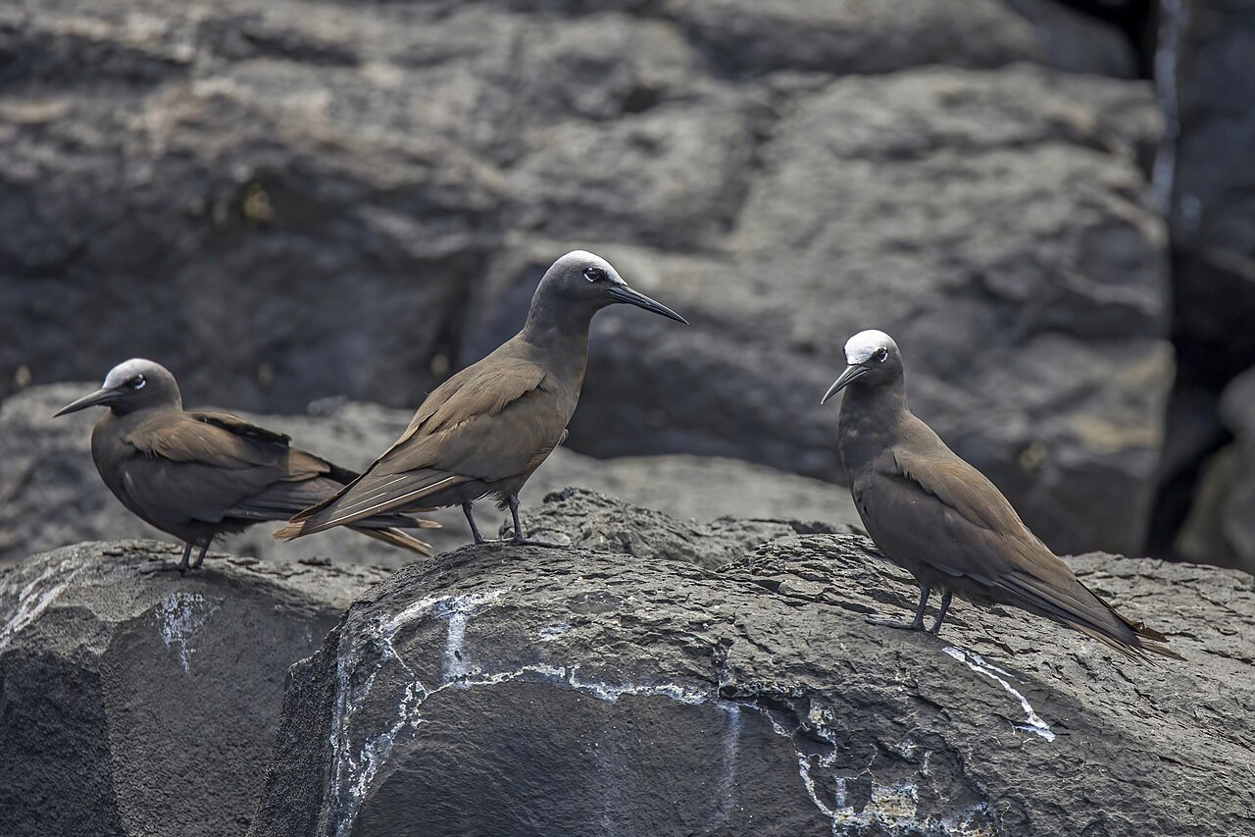
Seabird families of Oceania
8 seabird families in tropical Oceania and Palau
#1. Terns and noddies (Laridae)
Sharp beaks used in dipping or plunging for fish
They are usually colonial nesters
Adult Sooty Tern and eggs
Brown Noddies
Notes:
8 seabird families occur in tropical Oceania and all 8 families occur in Palau - these are:
#1. Terns and noddies (Laridae)
– Mainly sharp-beaked fish-eaters and some squid-eaters caught by surface-dipping (all species), plunging (
- Feed in lagoons, inshore or offshore/pelagic (the others)
- They are usually colonial nesters (one exception – can you name this).
Slide 19: Adult Sooty Tern and eggs Marinha do Brasil, CC BY-SA 2.0
Slide 19: Brown Noddies Charles J. Sharp - Own work, CC BY-SA 4.0

Slide 20
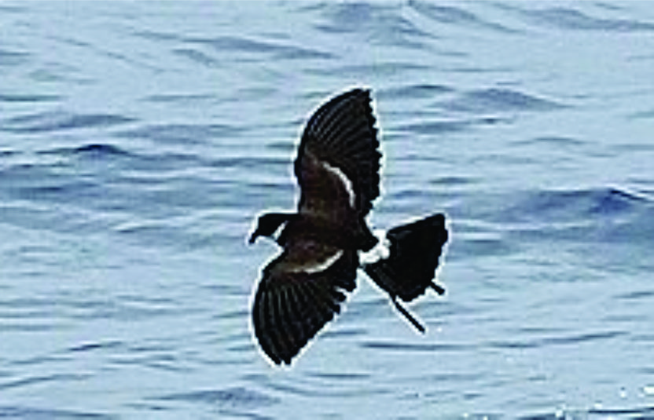
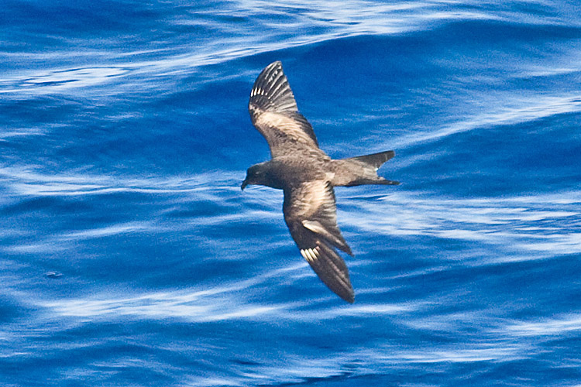
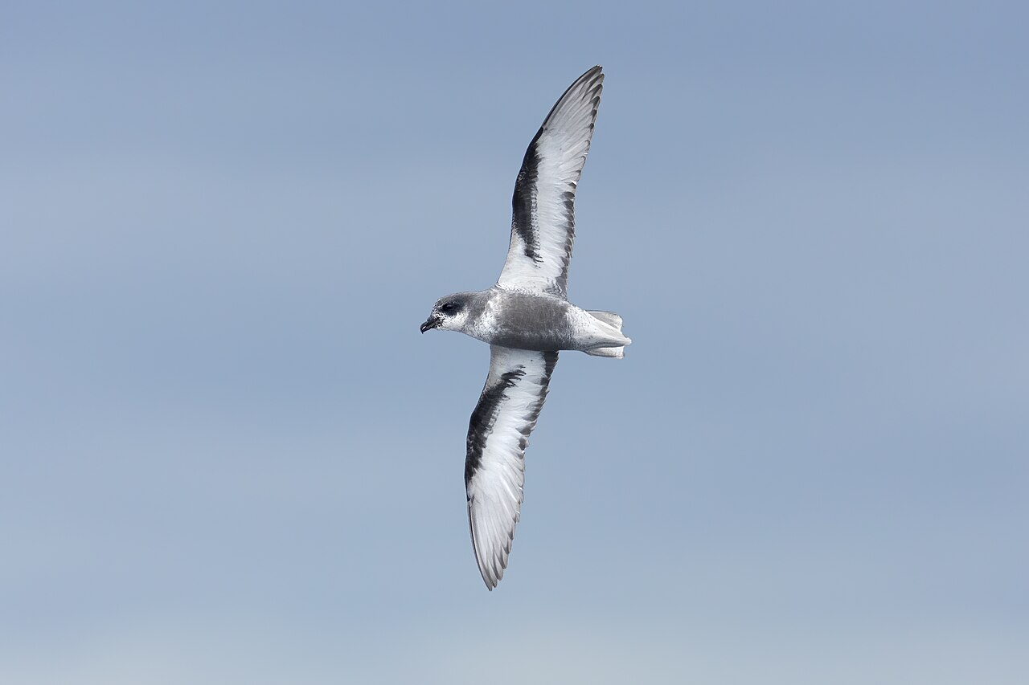
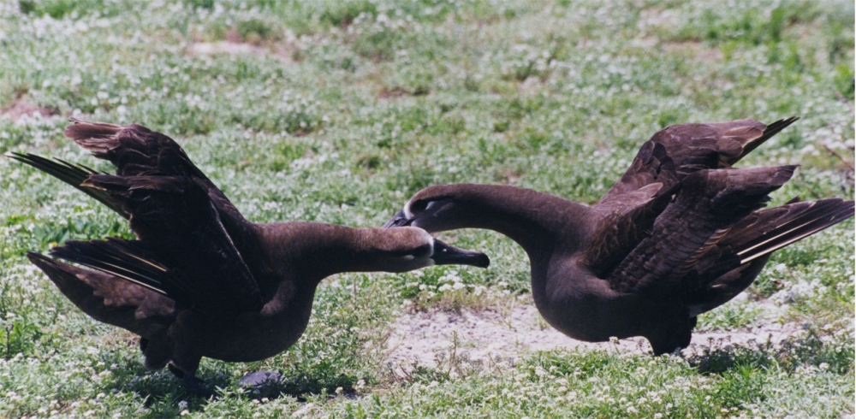
Seabird families of Oceania
Four families of tube-nosed seabirds
#2. Southern Storm-petrels (Oceanitidae)
#3. Northern Storm-petrels (Hydrobatidae)
#4. Albatrosses (Diomedeidae)
#5. Petrels and shearwaters (Procellariidae)
Polynesian Storm-petrel
Matsudaira’s Storm-petrel
Mottled Petrel
Black-footed Albatross
Notes:
These four families are the tube-noses as they have tubes on their beaks from which concentrated salt is excreted from their salt glands.
Includes the Southern and Northern Storm-petrels all of which feed on zooplankton which visit Palau at differing times of the year – southern winter/northern winter
A few albatross species breed in the northern Pacific not so far away and can pass through Palau waters. They are squid eaters and breed on undisturbed islands.
Petrels and shearwaters – these do breed here in Palau (which species?) Tropical Shearwater (ex Audubon’s in many guides) and we will discuss this colonial nester later; and many passage migrants.
Slide 20: Matsudaira’s Storm-petrel Tony Morris, CC BY-SA 2.0
Slide 20: Polynesian Storm-petrel James Eaton - iNaturalist, CC0
Slide 20: Black-footed Albatross dancing Brocken Inaglory, CC BY-SA 3.0
Slide 20: Mottled Petrel JJ Harrison - Own work, CC BY-SA 3.0

Slide 21
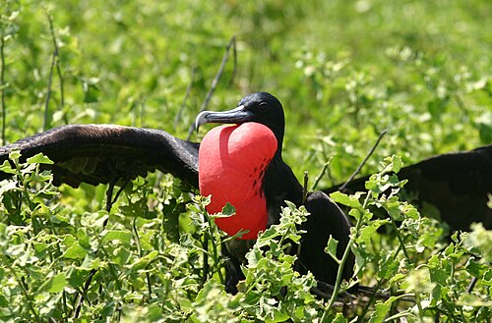
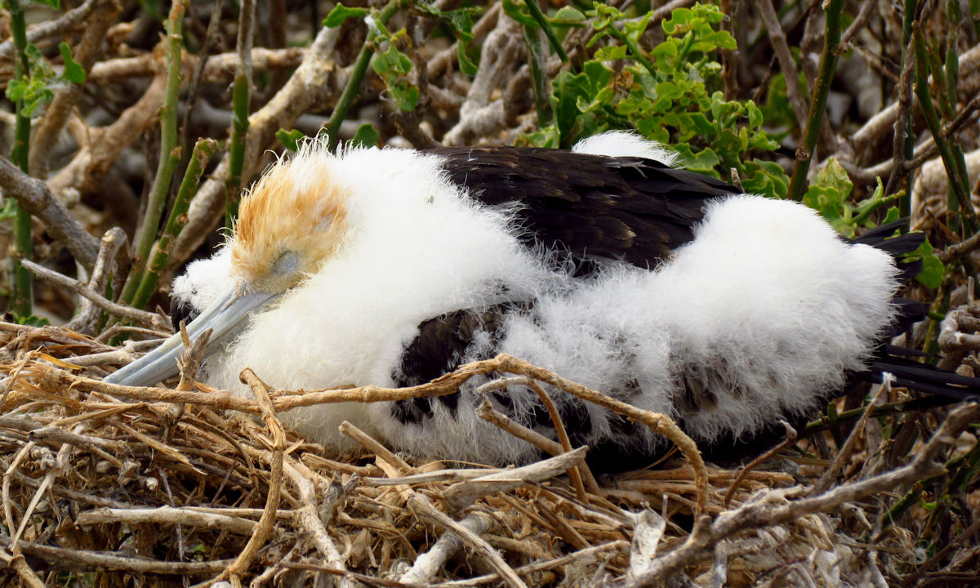
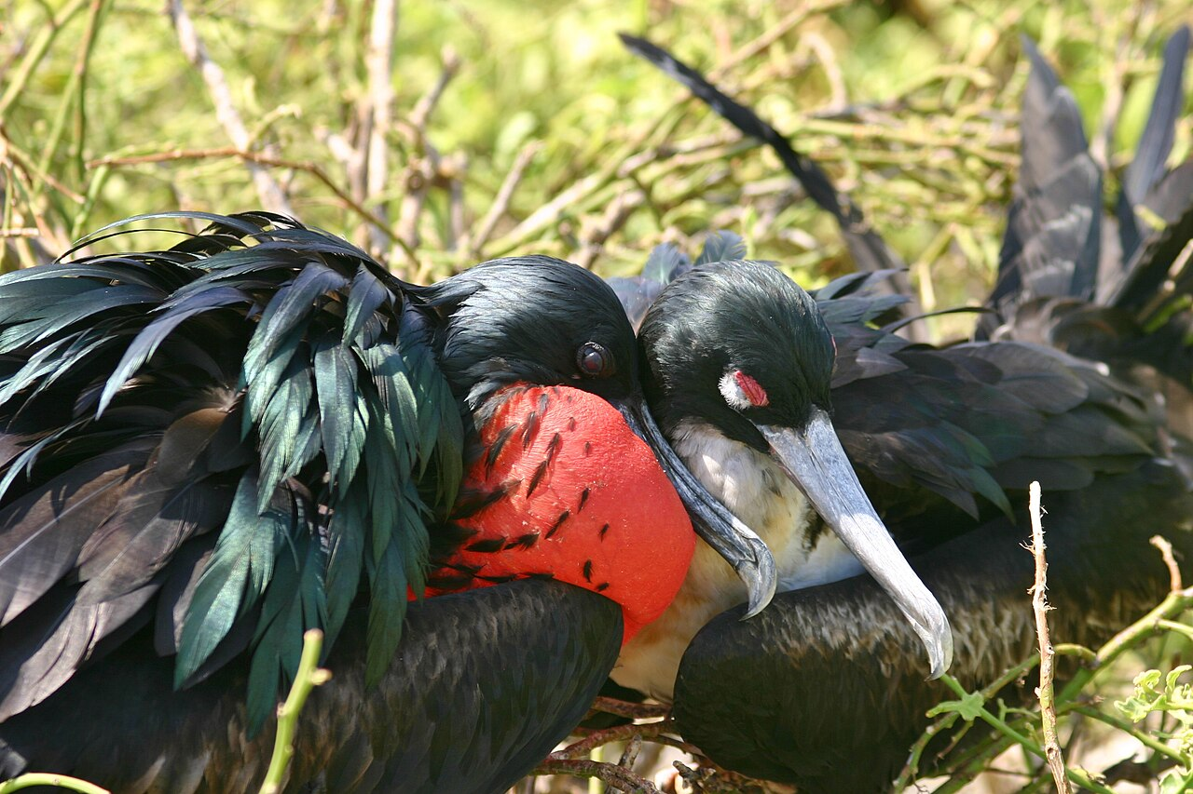
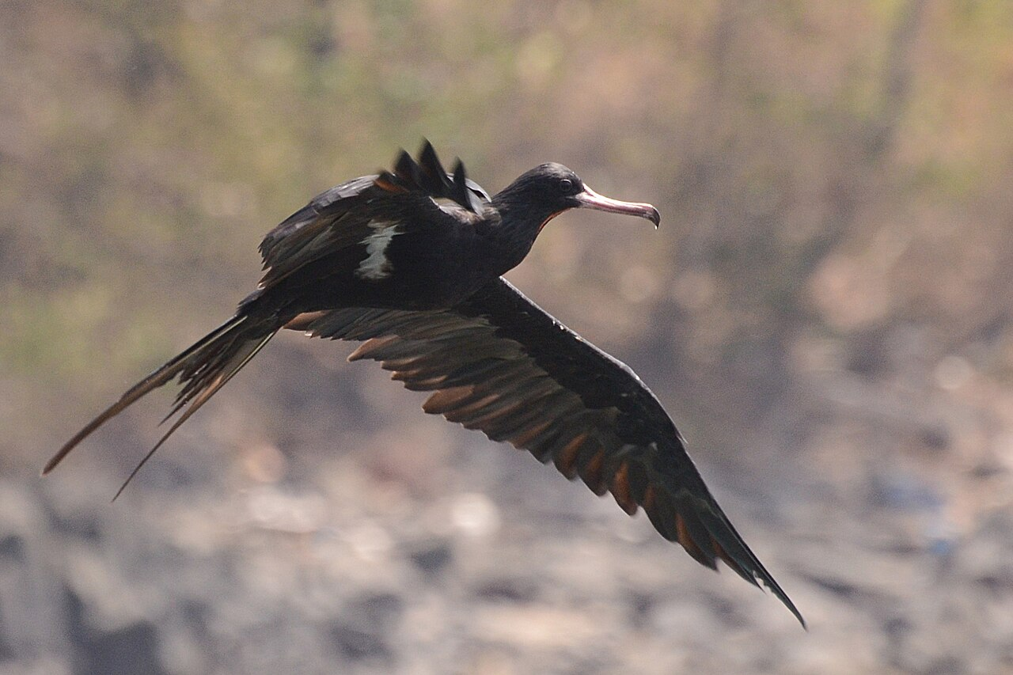
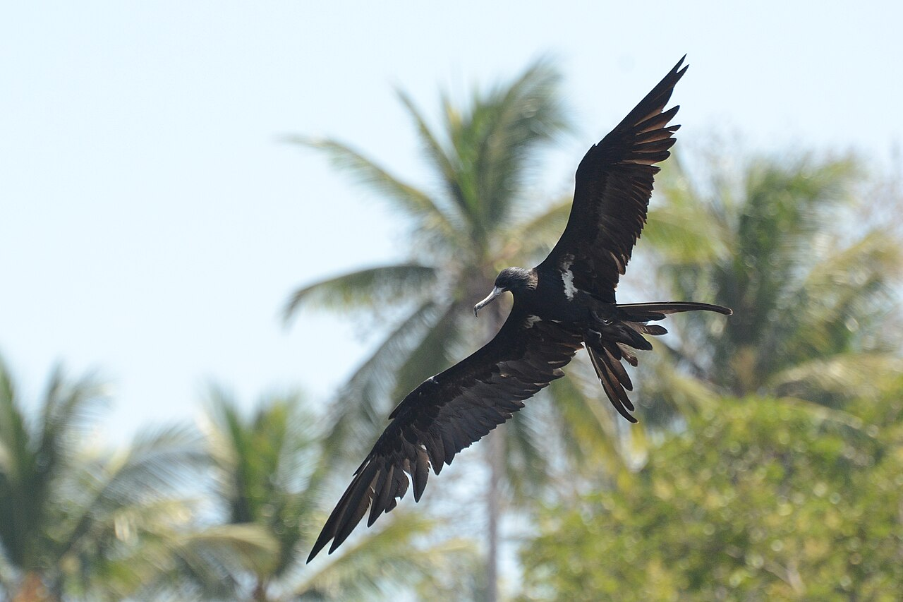
Seabird families of Oceania
#6. Frigatebirds (Fregatidae)
feed on fish and squid, colonial nesters
Great Frigatebirds
Lesser Frigatebirds
Notes:
Frigatebirds take pelagic fish and squid from the surface, but also steal other birds’ prey that are being brought back to the nest – island seabird colonies often have frigatebirds lurking overhead in wait. They nest in loose or dense colonies on ground or woody plants, displaying aerially or on ground with expanded red gular pouch.
Slide 21: Male Great Frigatebird displaying Charles J. Sharp - Own work, CC BY-SA 3.0
Slide 21: Chick D. Gordon E. Robertson - Own work, CC BY-SA 3.0
Slide 21: Breeding pair Charles J. Sharp - Own work, CC BY-SA 3.0
Slide 21: Male Lesser Frigatebird Ariefrahman - Own work, CC BY-SA 4.0
Slide 21: Male Lesser Frigatebird Ariefrahman - Own work, CC BY-SA 4.0

Slide 22
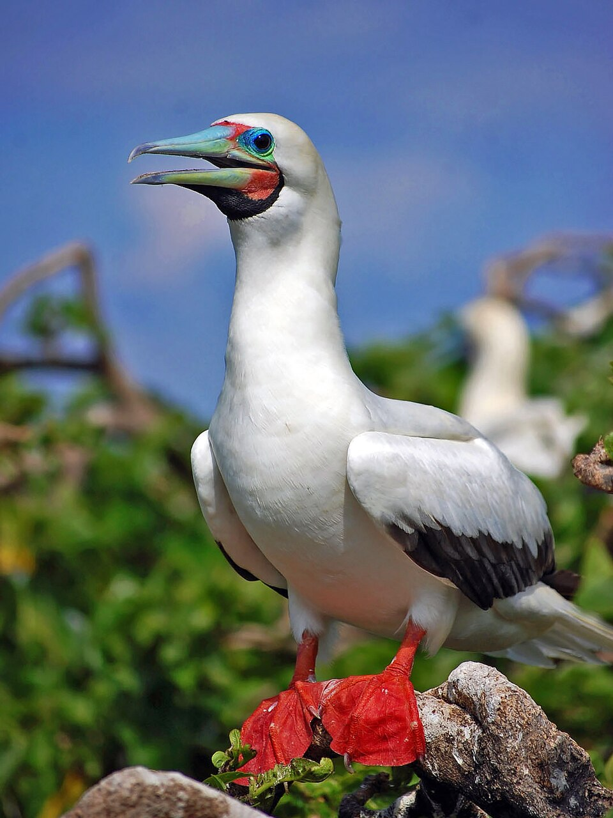
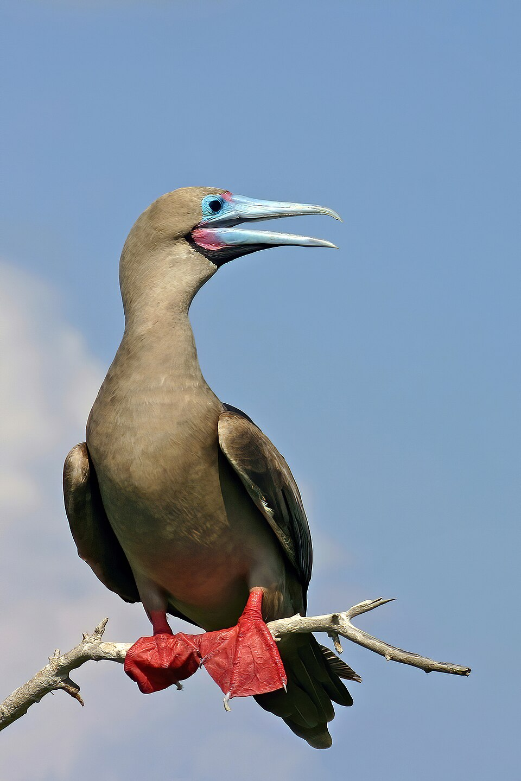
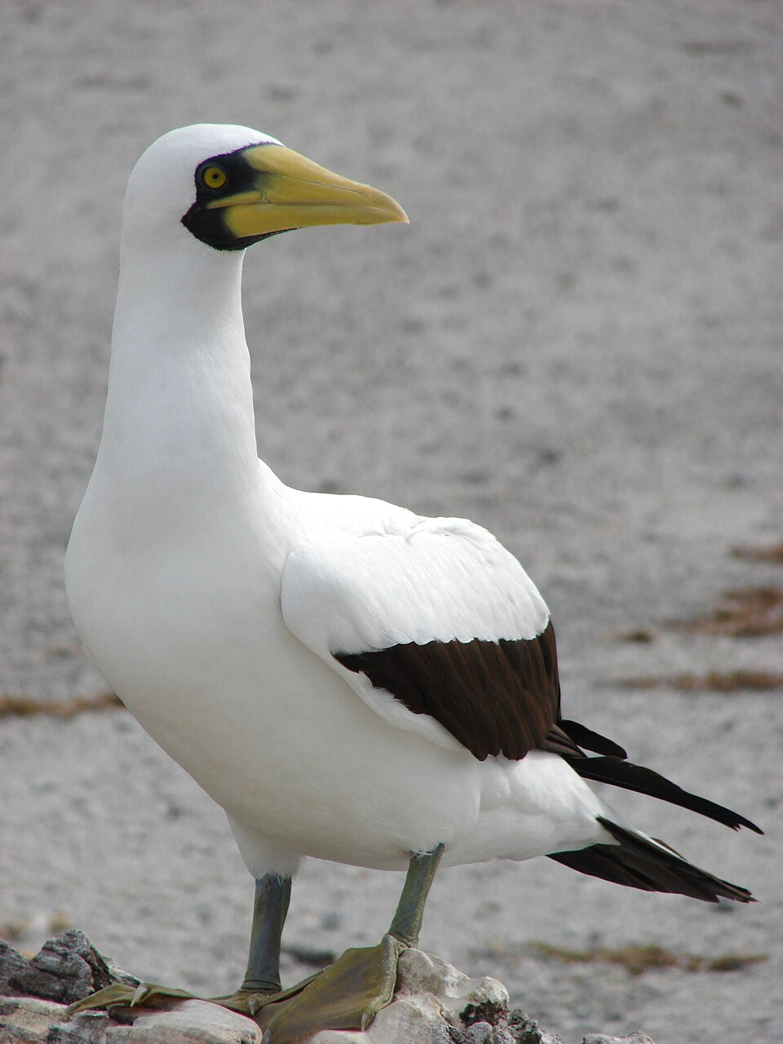
Seabird families of Oceania
#7. Boobies (Sulidae)
Fish and squid eaters; colonial nesters
Pied form
Brown form
Red-footed Booby
Masked Booby
Notes:
Boobies have powerful beaks and plunge-dive often from heights of 10+ m and take fish and squid. They are usually colonial nesters in trees or on ground.
Slide 22: Pied form of Red-footed Booby Gregg Yan, CC BY-SA 3.0
Slide 22: Brown form, adult male Charles J. Sharp - Own work, CC BY-SA 3.0
Slide 22: Adult Masked Booby Forest & Kim Starr, CC BY 3.0

Slide 23
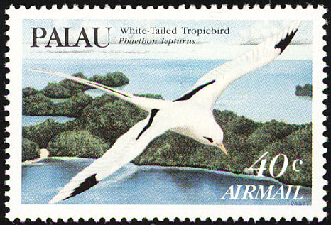
Seabird families of Oceania
#8. Tropicbirds (Phaethontidae)
Fish and squid eaters; solitary nesters, prominent elongated tail feathers.
Notes:
Tropicbirds are solitary pelagic feeders catching flying fish and squid by plunge-diving. They have elongated central tail feathers used in aerial display early in the breeding season.
Slide 23: tropicbird stamp, Government of Palau

Slide 24
Identifying the Seabirds of Palau
Palau supports important breeding numbers of at least 11 species of seabird of all the major groups, some globally important colonies so monitoring health and threats is important
There are many more pelagic species that pass through on seasonal migrations between northern and southern hemispheres, or disperse from other tropical breeding grounds
Notes:
Palau supports important breeding numbers of several species. They include all the major groups of seabirds, some colonies of global importance so monitoring health and threats is important
There are many more pelagic species that pass through on seasonal migrations between hemispheres, or disperse from other tropical breeding grounds and we’ll be dealing with different monitoring methods for them

Slide 25

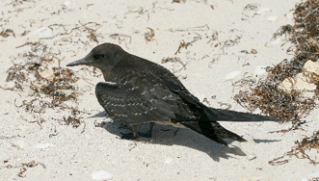
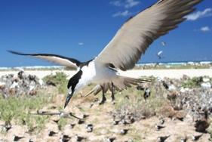
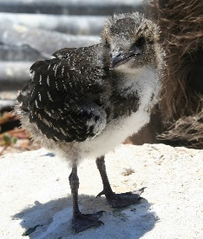
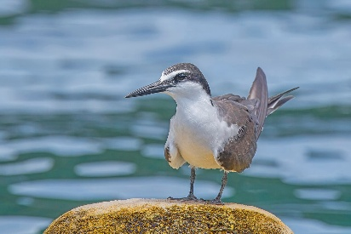
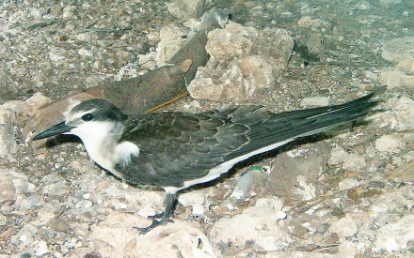
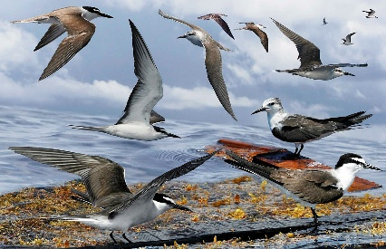
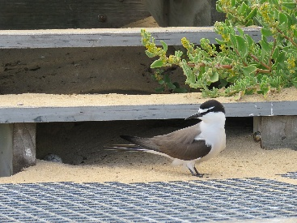
Sooty vs Bridled Terns
Sooty Terns are black and white
Bridled Terns are dark greyish black above
Adult with eggs
Juvenile
Colony
Chick
Sooty Tern
Adult in breeding plumage
Juvenile
Composite image
Adult with eggs
Bridled Tern
Notes:
Sooty Terns are black and white as adults, all black with white speckling in juveniles, flock feed pelagically, colonial nesters on surface, grating call – play audio
Bridled Terns are dark grey to black above with white above eye tapering narrowly backwards, solitary feeder near shore, crevice nesters. Has more mellow call – play audio as first indication Bridled are Around may be their characteristic calls
Slide 25: Adult Sooty Tern Marinha do Brasil, CC BY-SA 2.0
Slide 25: Juvenile Sooty Tern Toby Hudson - Own work, CC BY-SA 3.0
Slide 25: Sooty Tern colony Duncan Wright, USFWS - Own work, Public Domain
Slide 25: Chick Duncan Wright, USFWS - Own work, Public Domain
Slide 25: Bridled Tern in breeding plumage, Rock Islands Charles J. Sharp - Own work, CC BY-SA 4.0
Slide 25: Juvenile Bridled Tern Sputnikcccp at the English-language Wikipedia, CC BY-SA 3.0
Slide 25: Composite image Richard Crossley - The Crossley ID Guide Britain and Ireland, CC BY-SA 3.0
Slide 25: Adult with egg (under stair) Calistemon - Own work, CC BY-SA 4.0

Slide 26
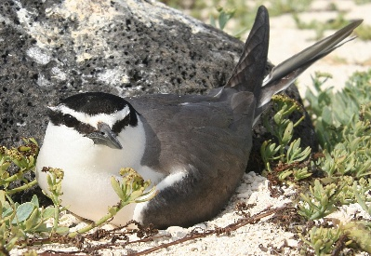
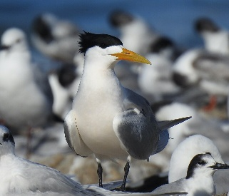
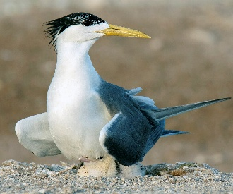
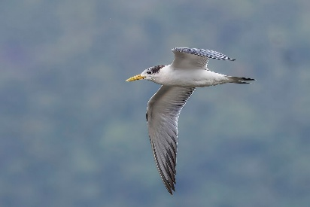
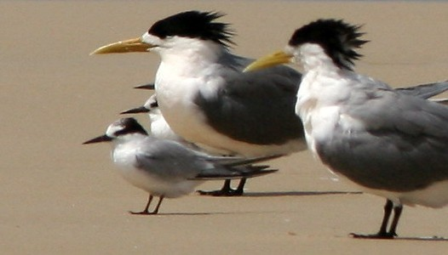
Grey-backed vs Greater Crested Terns
Grey-backed Terns are dark grey above, fine bill
Greater-crested Terns have large yellow bill
Grey-backed Tern on egg
Adult
Adult with chick
Immature
With Little Tern
Greater Crested Tern
Notes:
Grey-backed Terns are migratory terns from the central Pacific but could potentially breed in Palau. They have grey back and wings, black head, white underparts, fine bill.. Same size as Sooty and Bridled and can be confused with Bridled
Greater-crested Terns are huge, grey and white, black cap, and a large yellow bill, often feed close to shore.
Both species nest in loose colonies
Slide 26: Grey-backed Tern on egg Duncan Wright - USFWS Hawaiian Islands NWR, Public Domain
Slide 26: Greater Crested Tern mattf1996 - iNaturalist, CC BY 4.0
Slide 26: Adult with chick Borhan Pak - Own work, CC BY-SA 4.0
Slide 26: Immature Greater Crested Tern Charles J. Sharp - Own work, CC BY-SA 4.0,
Slide 26: With Little Tern Jimfbleak - derived from work by Glen Fergus, CC BY-SA 2.5

Slide 27
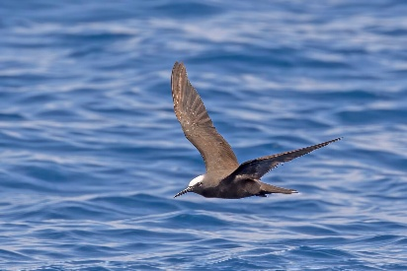
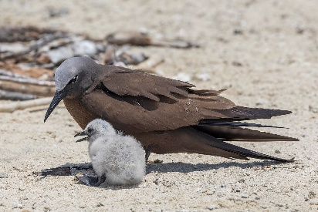
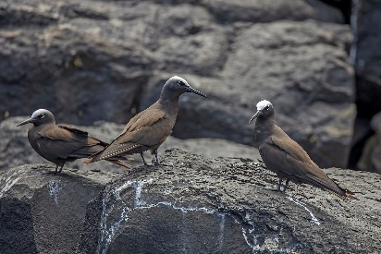
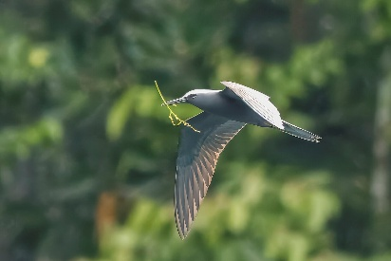
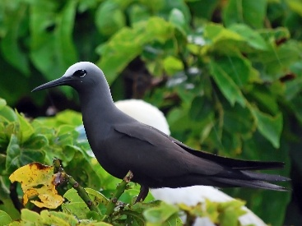
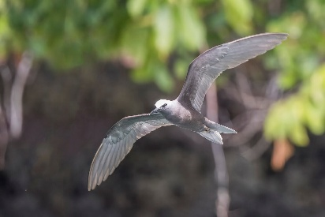
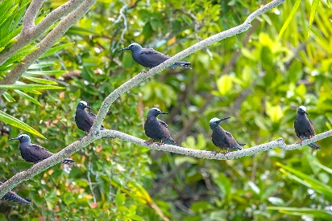
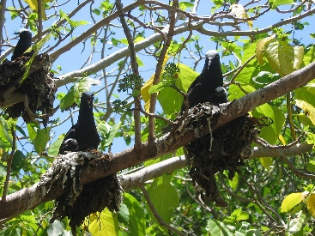
Brown vs Black Noddies
Brown Noddies are brown with pale cap
Black Noddies are black, white cap, sharp call
Brown Noddy
Black Noddy
Notes:
Brown Noddies are elongate with brown coloured bodies with a creamy coloured cap
Black Noddies are a more compact, blackish seabird with white cap - play audio of both as the calls are markedly different
Slide 27: Brown Noddy Charles J. Sharp - Own work, CC BY-SA 4.0
Slide 27: Adult with chick Charles J. Sharp - Own work, CC BY-SA 4.0
Slide 27: Brown Noddies Charles J. Sharp - Own work, CC BY-SA 4.0
Slide 27: With nesting material, Palau Charles J. Sharp - Own work, CC BY-SA 4.0
Slide 27: Black Noddy Gregg Yan, CC BY-SA 3.0
Slide 27: In the Rock Islands Charles J. Sharp - Own work, CC BY-SA 4.0
Slide 27: In the Rock Islands Charles J. Sharp - Own work, CC BY-SA 4.0
Slide 27: Adults nesting, with chicks Nogwater from Oak Park, CA, USA, CC BY-SA 2.0

Slide 28
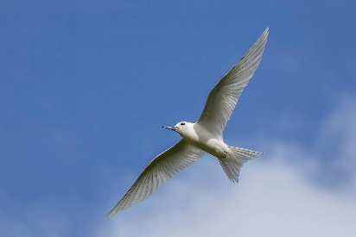
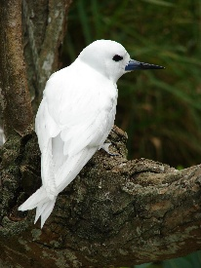
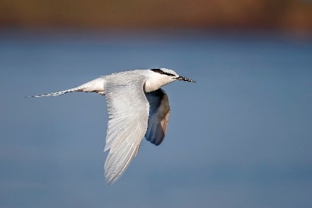
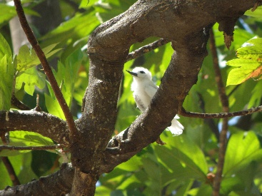

White Tern vs Black-naped Tern
Blue-billed White Terns are all white, bluish bill
Black-naped Terns are all white, black nape band
Juvenile
White Tern
Black-naped Tern
Notes:
Blue-billed White Terns are all white with a blue and black coloured bill. Young have less blue on bill than do adults.
Pelagic feeder and tree-nesters.
Black-naped Terns are all white with a striking black band on the back of the head.
Lagoon feeding on fish. Ground-nesters.
Play audio of both if needed.
Slide 28: Blue-billed White Tern Charles J. Sharp - Own work, CC BY-SA 4.0
Slide 28: Juvenile Monica Gruber, Pacific Biosecurity
Slide 28: Adult Forest & Kim Starr, CC BY 3.0
Slide 28: Black-naped Tern Mvbellad - Own work, CC BY-SA 4.0
Slide 28: In breeding plumage Charles J. Sharp - Own work, CC BY-SA 4.0

Slide 29





Migrant terns of wetlands
Whiskered, White-winged, Little and Common Terns of intertidal areas and wetlands
Summer breeding colors
White-winged Black Tern
Little Tern
Non-breeding plumage
Common Tern
Whiskered Tern
Notes:
Whiskered, White-winged, Little and Common Terns (illustrated)
These are likely to pass through on migration between eastern Asia and Australasia.
They are more likely to be in intertidal areas and wetlands.
Slide 29: Whiskered Tern in summer breeding colors Charles J. Sharp - Own work, CC BY-SA 4.0
Slide 29: Whiskered Tern in non-breeding plumage Charles J. Sharp - Own work, CC BY-SA 4.0
Slide 29: White-winged Black Tern Nrg800 - Own work, CC BY-SA 4.0
Slide 29: Little Tern PetroKaterynych - Own work, CC BY 4.0
Slide 29: Common Tern MPF - Own work, CC BY-SA 4.0

Slide 30
Great vs Lesser Frigatebirds
Great Frigatebird is larger than Lesser, male all black
No white underwing
Juvenile
Female has a white breast
Great Frigatebirds
White underwing
Lesser Frigatebirds
Notes:
The Great Frigatebird is the common frigatebird in Palau, and breeds here, but birds need to be carefully examined to make sure it isn’t the Lesser Frigatebird which might also breed in Palau.
In some other countries e.g. Tokelau they have recovered from dispersing birds from productive breeding grounds 500 km away.
Great Frigatebird male all black (no underwing white): female pied (white breast): juvenile rusty head and breast
Lesser Frigatebird smaller than Great (most noticeable in tail), glossy, male is all black with narrow white bar in underwing; female pied; juveniles rusty head.
Slide 30: Male Great Frigatebird displaying Charles J. Sharp - Own work, CC BY-SA 3.0
Slide 30: Chick D. Gordon E. Robertson - Own work, CC BY-SA 3.0
Slide 30: Breeding pair Charles J. Sharp - Own work, CC BY-SA 3.0
Slide 30: Male Lesser Frigatebird Ariefrahman - Own work, CC BY-SA 4.0
Slide 30: Male Lesser Frigatebird Ariefrahman - Own work, CC BY-SA 4.0

Slide 31

Mentimeter
What species of frigatebird are the flying males in this image?
Notes:
What species are the flying males in this slide?
Slide 31: Ray Pierce

Slide 32

Boobies
Red-footed Boobies have red feet! Pied or dark
Brown Boobies are chocolate brown and white
Masked Booby are large pied, black mask.
Brown Booby
Pied form
Brown form
Red-footed Booby
Masked Booby
Notes:
Red-footed Boobies have red feet! Dimorphic with pied and all dark forms. Tree-nester.
Brown Boobies are chocolate brown above, white below, juveniles darker, G round-nester. Photograph any unusual white-collared “Brown Boobies” as these could be visiting Townsend’s Boobies
Masked Booby are large pied boobies with black mask over face. Potential visitor?
Slide 32: Pied form of Red-footed Booby Gregg Yan, CC BY-SA 3.0
Slide 32: Brown form, adult male Charles J. Sharp - Own work, CC BY-SA 3.0
Slide 32: Adult Masked Booby Forest & Kim Starr, CC BY 3.0
Slide 32: Adult Brown Booby Danilo da Castro - Own work, CC BY-SA 3.0

Slide 33

Mentimeter
How many species are in this image?
What species are they?
Notes:
How many species are present and what are they – frigatebird is long-beaked, long tail, ,low gloss; Great.
Boobies are a mix of Masked and Brown the latter including an adult (chocolate and white) and a juvenile all chocolate.
Slide 33: Ray Pierce

Slide 34






Tropicbirds
White-tailed Tropicbirds have yellow bill and white tail streamers. Nest in tree crevices
Red-tailed Tropicbirds have red bill and red tail streamers. Potential visitor, ground-nester.
White-tailed Tropicbirds
Red-tailed Tropicbirds
Notes:
White-tailed Tropicbirds are white with yellow bill and a black line in the wing (speckled in juveniles). White tail streamers. Nest in tree crevices
Red-tailed Tropicbirds are white with a red bill and red tail streamers. Potential visitor, ground nester.
Slide 34: White-tailed Tropicbird Marion Schneider & Christoph Aistleitner - Own work, Public Domain
Slide 34: kansasphoto - Flickr, CC BY 2.0
Slide 34: HarmonyonPlanetEarth, CC BY 2.0
Slide 34: Red-tailed tropicbird Francesco Veronesi, CC BY-SA 2.0
Slide 34: Juvenile SurreyJohn - Own work, CC BY-SA 4.0
Slide 34: DickDaniels - Own work, CC BY-SA 3.0

Slide 35

Pelagic seabirds - Northern Storm-petrels
Matsudaira’s Storm-petrel (VU) is dark grey
Leach’s Storm-petrel similar but white rump
Matsudaira’s Storm-petrel
Leach’s Storm-petrel
Notes:
Matsudaira’s Storm-petrel (VU) is dark grey with conspicuous white wing bars (Migratory from southern Japan islands)
Leach’s Storm-petrel is dark grey with conspicuous white wing bars and white rump. (Migratory from North Pacific)
What is the species in slide? LSP
For pelagic identification from boats, it can help to video in field and examine on computer screen later.
Slide 35: Matsudaira’s Storm-petrel Tony Morris, CC BY-SA 2.0
Slide 35: Leach’s Storm-petrel Alexis Lours - Own work, CC BY 4.0

Slide 36

Pelagic seabirds - Southern Storm-petrels
Polynesian Storm-petrel is black and white
Wilsons Storm-petrel is black with white rump
Polynesian Storm-petrel
Wilson's Storm-petrel
Notes:
Polynesian Storm-petrel is black above with conspicuous white upper tail, and white below with black collar, white chin. (possible visitor from central Pacific).
Wilsons Storm-petrel is mostly black with white rump, pale wing bars. (Possible visitor from south in southern winter).
Slide 36: Polynesian Storm-petrel James Eaton - iNaturalist, CC0
Slide 36: Wilson's Storm-petrel JJ Harrison - Own work, CC BY-SA 3.0

Slide 37


Pelagic seabirds - Albatrosses
Black-footed Albatrosses are large and dark
Laysan Albatross is much whiter
Black-footed Albatross
Laysan Albatross
Notes:
Black-footed Albatrosses are large dark albatrosses with a whitish face and visit Palau pelagic from their N Pacific breeding islands.
Other albatrosses, e.g. the much whiter Laysan, are potential visitors
Slide 37: Black-footed Albatross Jlfutari, CC BY-SA 3.0
Slide 37: DickDaniels - Own work, CC BY-SA 3.0

Slide 38






Pelagic seabirds – Petrels and Shearwaters
Several petrel and shearwater species migrate through Palau waters
They are tricky to identify – take photos/videos
Mottled Petrel
Black-winged Petrel
Cook's Petrel
White-necked Petrel
Wedge-tailed Shearwater
Sooty Shearwater
Buller’s Shearwater
Notes:
Several petrel and shearwater species migrate through Palau pelagic waters peaking about March-May and September-November, e.g. Mottled Petrel, Black-winged and Cooks Petrel from NZ region, White-necked and Juan Fernandez Petrels from E Pacific, Bulwer’s Petrel from N Pacific. Wedge-tailed (potential resident angular wings, dark or pied morphs), Streaked (streaked), Short-tailed (black), Sooty (black with silvery underwing flash), Flesh-footed (large, blackish brown), Buller’s (large, pied).
They are tricky to ID – take photos/videos
Depending on objectives of Palau rangers a simple pictorial guide to the more likely visitors could be prepared.
Slide 38: Mottled Petrel JJ Harrison - Own work, CC BY-SA 3.0
Slide 38: Black-winged Petrel Christopher Watson, CC-BY-SA 3.0
Slide 38: Cook's Petrel JJ Harrison - Own work, CC BY-SA 3.0
Slide 38: White-necked Petrel JJ Harrison - Own work, CC BY-SA 3.0
Slide 38: Wedge-tailed Shearwater Duncan Wright - USFWS, Public Domain
Slide 38: Sooty Shearwater JJ Harrison - Own work, CC BY-SA 3.0
Slide 38: Buller’s Shearwater JJ Harrison - Own work, CC BY-SA 3.0

Slide 39




Pelagic seabirds – Don’t forget the residents!
Local breeders will also be out in the ocean as well – Palau’s Tropical Shearwaters, terns/noddies, frigatebirds, boobies, tropicbirds
White-tailed Tropicbird
Great Frigatebird
Black Noddy
Sooty Tern
Notes:
Don’t forget that local breeders will also be out there in the pelagic realm – Palau’s Tropical Shearwaters, plus terns, noddies, frigatebirds, boobies and tropicbirds will be out there as well.
Slide 39: White-tailed Tropicbird Damien Wallace / CC BY-NC 4.0
Slide 39: Great Frigatebird John Bruin / CC BY-NC 4.0
Slide 39: Black Noddy yuys / CC BY-NC 4.0
Slide 39: Sooty Tern andybrooke / CC BY-NC 4.0

Slide 40
Seabirds of Palau
On the website version of the Manual https://seabirds.pacificbiosecurity.co.nz/index.php?page=seabirds-of-palau
Links to records from various databases
Images and links to more information
List of all seabird species breeding in Palau
Identifying Palau’s seabirds (from Ray’s notes)
Palau Seabird Keys for Identification – decision trees
Notes:
We created a section in the website version of the manual to focus on seabirds in Palau, mostly to help you understand what is here and help you identify them.
It has information on Palau seabirds from various sources.
The links on the iNaturalist and eBird columns in the table take you to Palau information on those databases, but it does include all birds, so you will need to scroll down to look for seabirds.
Based on previous records we may see as many as 31 species on our field trip.
The Identifying Palau's seabirds has information from Ray’s presentation as well as images.
I’ve also developed a set of questions in decision trees that may help you identify seabirds.
The Palau's seabird colonies page has a list of all seabird species breeding in Palau, extracted from the Pacific Seabird Colony Database.
[skip to website]

Slide 41
Exercise: Identifications
Objective: Improve seabird identification skills
In groups, look at the photographs of seabirds on this page (https://seabirds.pacificbiosecurity.co.nz/index.php?page=id-exercise). Discuss and note down
  Species name
  Key features you used for identification
If applicable, make additional notes on:
  Age class, such as chick, juvenile, adult
  Male or female
  Breeding status
You can use the Seabirds of Palau resources at https://seabirds.pacificbiosecurity.co.nz/index.php?page=identifying
Notes:
[skip to website]: https://seabirds.pacificbiosecurity.co.nz/index.php?page=id-exercise
[skip to website]: https://seabirds.pacificbiosecurity.co.nz/index.php?page=identifying

Slide 42
Identification answers
Image 1
Image 2
Image 3
Image 4
Image 5
Image 6
Image 7
Image 8
Image 9
Image 10
Red-footed Booby
Red-footed Booby
Brown Booby
Sooty Tern
Bridled Tern
Tropical Shearwater
Brown Noddy
Brown Noddy
Black Noddy
Great Frigatebird

Slide 43
Mentimeter – Identification resources
Which species were most difficult to identify?
Which resources did you use?
How could the identification resources be improved?

Slide 44

The Pacific Seabird Colony Database
Information on seabird colonies throughout the Pacific: https://pacific-seabirds.sprep.org/
Notes:
The Pacific Seabird Colony Database records all known resident breeding colonies in the Pacific.
The database is a starting point for Pacific Island Countries and Territories and Partners to build knowledge of seabirds of the Pacific, their distribution and especially over time their population trends.
Countries, partners, researchers and seabird enthusiasts are encouraged to contribute existing data as well as plan resurveys of key colonies where information is over 10 years old.
Data will also be important for reporting on progress in multilateral environmental agreements (MEAs) for example on National Biodiversity Strategies and Action Plans (NBSAPs).
You can update the database, and we will talk about this more on Friday. We might even have some data to update it with!
[skip to database]
The database is pretty straightforward to use.
You can select a species, EEZ and survey period or just one of these aspects.
To view all the information for Palau, just choose the Palau EEZ.
The map will zoom into Palau.
You can then zoom in further to see specific locations.
If you click on a location name it will bring up the list of species found at that location.
And if you click on a species name it will tell you about the species and where else it is found in the Pacific.
There are also links to the IUCN Red List data for the species and a Global Population Assessment.
If you scroll down you can see the details for all locations.
We chose Ulebsechel, Ngeanges and Ulong as our site for field surveying tomorrow, because of the differences between them.
For example rats were removed from Ulong recently and birds have recovered.
There was a failed eradication and Ngeanges.
And I suspect that rats have rats have always been present at Ulebsechel.
So we should see differences because of the different threat profiles.

Slide 45
Mentimeter - the Pacific Seabird Colony Database
Which seabird species are breeding in Ngeanges?
Are Greater Crested Tern breeding in Ngeruktabel?
How many seabird species are breeding in Ulong?

Slide 46
BREAK

Slide 47
1) Parking lot

Slide 48

Seabird-driven ecosystems
Notes:
Seabirds can breed in very large colonies of thousands, sometimes millions, of birds
They are ecosystem engineers modifying terrestrial and marine ecosystems by:
- their droppings contribute nutrients especially beneficial N and P to land and sea leading to:
- nutrients promote plant growth and diversity
- plants promote invertebrate abundance and diversity
- burrowing contributes further diversity, seed dispersal, etc
- nutrients promote coral reef growth and enhance diversity of the reef community
Slide 47: Current Conservation. (2025, April 16). The Seabird Nutrient Cycle [Illustration]. In Seabirds are nutrient factories for coral reefs. https://www.currentconservation.org/seabirds-are-nutrient-factories-for-coral-reefs/

Slide 49
Seabird-driven ecosystems
Research at Palmyra and elsewhere has shown the benefits of large seabird colonies
The best scenarios for island health are
  native vegetation dominating
  no mammalian* predators
  effective biosecurity to prevent other alien predators and other threats like disease arriving
* mammalian = like cats, rats, feral dogs, pigs
Notes:
Research at Palmyra (in the Line Islands) and elsewhere has shown the benefits of large seabird colonies and measured the beneficial impacts of recovering colonies after pest removal etc.
The research reveals the best scenarios for island health are:
- indigenous vegetation dominates
- no mammalian predators
- effective biosecurity to prevent other alien predators and other threats like disease arriving

Slide 50


Threats to seabirds on land
Notes:
Seabirds face many threats on land and at sea.
Introduced predators and habitat loss are the key terrestrial threat
Examples – rats, cats, pigs, dogs, invasive ants (e.g little fire ant), brown tree snake, mongoose
Impact - they can reach high densities and remove eggs, chicks, adults at a faster rate than the birds can breed and be replaced.
Past and present vectors – cargo boats, fishing boats, inter-island vessels, planes, etc.
Harvesting/poaching of eggs, chicks, adults often unsustainable especially of adults.
Disease e.g. avian influenza currently impacting species in common with Australia
Slide 49: image of threats created by Nano banana 2 in Google AI

Slide 51



Threats to seabirds at sea
Notes:
At sea threats include:
Fisheries activities e.g. long-line by-catch and potentially depletion of keystone species, e.g. tuna
Pollution especially direct impacts of plastic on birds – choking, entanglement, oil pollution, etc.
Climate change multi-impacts via changes in sea-level, temperature, pH, turbidity, etc.
Slide 50: image of threats created by Nano banana 2 in Google AI

Slide 52
Mentimeter
What do you consider to be the biggest threats to seabirds in Palau?

Slide 53
Part 2: Survey tools & types
2.1 Survey tools (12 sub-sections)
    2.1.2 Community surveys
    2.1.3 Acoustic surveys
    2.1.6 Camera monitoring
2.2 Survey types (12 sub-sections)
    2.2.1 Rapid assessment
    2.2.2 Threat assessment
    2.2.4 Colony surveying
    2.2.8 Shore-based surveys
    2.2.9 At-sea surveying
    2.2.11 Shoreline surveying
    2.2.12 Finding breeding sites
Notes:
Now we are going to cover Part 2 of the manual, which covers the tools for surveying seabirds.
…
This part has two sections, each with 12 sub-sections.
The sections we will cover are in bold text.
Depending on time constraint we may have to cut some topics short but we can cover those on Thursday (Day 3).
And you might wish to also discuss acoustic surveys and monitoring. Let us know by using the parking lot.

Slide 54

Survey tools
Be prepared – have a plan, records of past surveys, etc.
Basic tools – eyes and ears
Essential aids – binoculars, camera, ID, notebook or equivalent, GPS, telescope
Specialist equipment if needed
Safety gear
Notes:
Being prepared – have a plan, familiar with background surveys, overall plans, and knowledge of species and objectives
Basic tools are your eyes and ears and knowing the signs and sounds…
Essential aids – binoculars, camera with zoom, bird ID guide or app, notebook or equivalent, datasheet if relevant, GPS, telescope for shore-based obs
Specialist equipment – motion cameras and acoustic equipment can help for detections of rare target species at remote locations
Safety gear – protective clothing, appropriate footwear, first aid, emergency comms.
Slide 53: Ray Pierce

Slide 55

Community surveys
Traditional and current community knowledge
Rare species or unusual species
Threats and problems such as diseased birds, invasive mammals like rats and cats
Recruiting people for monitoring, coordinating, and so on
Tarakoi habitat restoration with the local community of Rapa
Notes:
Traditional knowledge and current observations in the community will be valuable in different ways, e.g.:
- when seeking knowledge of rare species that may or may not be nesting, e.g. Wedge-tailed Shearwater
- sightings of unusual species, e.g. albatrosses
- when seeking information on issues e.g. diseased birds or invasive species
- recruiting local community members in monitoring projects = growing the capacity
- have designated local coordinator record their opportunistic sightings on a datasheet
Slide 54: PSSMM Figure 25. Tarakoi habitat restoration (removal of Melinis grass) with the local community of Rapa. Photo: SOP Manu.

Slide 56
Survey types
These will depend on your objectives
What seabird species occur on this island?
  Use daytime and evening rapid assessment surveys
What invasive species are present?
  Invasive species assessment
If multiple objectives, very careful planning is needed
Try to keep methods simple and replicable
Notes:
Depending on your objectives several survey types might be applicable, e.g.
What seabird species occur on this island? Use daytime and evening rapid assessment surveys discussed next slide
What invasive species are present? Invasive species assessment (coming up)
If multiple objectives, very careful planning is needed
Try to keep methods simple and replicable.

Slide 57
Survey types - Rapid assessment surveys
Plan - literature review, consultation
Repeat seasonally (once per season)
Ground surveys – targeted searches for nests in trees, on ground and in burrows/crevices, map colonies and count/estimate nests
Evening fly-ons –from downwind points on shore or boat
Petrels/shearwaters? - deploy acoustic recorders after survey
Threats assessment – separate team focused on threats
Notes:
Rapid assessment surveys
Plan - do literature review, consult locals, timing
Seasonally repeat once to include all breeding calendars
Ground surveys –do random but targeted surveys for presence of nests in trees, on ground and in burrows/crevices, map colonies and count/estimate nests
Evening fly-ons – watch from downwind points on shore or from vessel immediately offshore
Petrels/shearwaters possible here/inconclusive? - deploy acoustic recorders after survey
Threats assessment – ideally have separate team focus on threats, but all aware of sign,

Slide 58
Finding and quantifying colonies (1)
1. The searches
General – seasonal (often 2 pulses a year)
Terns – look in open areas for birds returning with fish, note flight direction and focus in on these, noisy sites
Noddies – Brown Noddy on ground in open areas, often with terns. Black Noddy – look for black nests in trees, and birds returning with fish like terns
Tropical Shearwater – under cover of vegetation, coral crevices/slabs, smell and hear them, watch incoming birds at dusk
Frigatebirds – look for large groups in the sky that may indicate nests/roosts directly below in trees, shrubs (Greater Frigatebird, Lesser on ground).
Boobies – Red-footed obvious colonies, nests in trees, Brown more hidden and isolated ground-nester
Notes:
1. The searches
General – seasonal (often 2 pulses a year)
Terns – look in open areas for birds returning with fish, note directions and home in on these, noisy sites
Noddies – Brown Noddy on ground in open areas, often with terns. Black Noddy – look for black nests in trees, birds returning with fish as per terns
Tropical Shearwater – under cover of vegetation, coral crevices/slabs, smell them, watch incoming birds at dusk
Frigatebirds – look for aerial congregations that may indicate nests/roosts directly below in trees, shrubs (Greater Frigatebird, Lesser on ground).
Boobies – Red-footed conspicuous colonies nests in trees, Brown more isolated ground-nester

Slide 59
Finding and quantifying colonies (2)
2. What to record
Date, location (site name and GPS), Observer(s)
Species, e.g. Bridled Tern
Colony size – estimate number of nests seen and whether this was complete coverage, e.g. 160 nests, 90+% of colony area covered
Estimate nesting stages if possible e.g. 30% new empty nest, 30% eggs/incubate, 30% young, 1% fledged juveniles, 10% unknown, etc
Note any unusual mortality – e.g. 50+ dead birds, emaciated (suggests starvation); egg fragments (photograph and compare with known photos)
* emaciated = thin, in poor condition
Notes:
2. What to record
Date, location (site name and GPS), Observer(s)
Species, e.g. Bridled Tern
Colony size – estimate number of nests seen and whether this was complete coverage, e.g. 160 nests, 90+% of colony area covered
Estimate nesting stages e.g. 30% new empty nest, 30% eggs/incubate, 10% nestling (naked), 20% feathered young, 1% fledged juveniles, 10% unknown
Note any unusual mortality – e.g. 50+ dead birds, emaciated (this would suggest starvation); egg fragments (photograph these and compare with known photos).
If these data are recorded then it may provide a baseline for ongoing monitoring and we’ll look at data sheets after the break.

Slide 60
Survey types - Threats assessment (1)
Planning – literature review, consult locals, timing
Observations for invasives directly on site include snap-trapping if overnighting, ant lures, camera traps
Look for invasives sign (scats, predation on seabirds), rats leave finer jagged edges to egg-shell than do cats, and cats are messy eaters to head and visceral organs
If inconclusive consider further trapping and camera work
Keep watch for invasive plants (even native plants) and other entrapment issues, etc.
Evaluate impacts (see table)
Notes:
Planning – literature review, consult locals, timing
Observations for invasives directly on site include snap-trapping, camera traps.
Look for invasives sign (scats, predation on seabirds), rats leave finer jagged edges to egg-shell than do cats, and cats are messy eaters to head and visceral organs
If inconclusive consider eDNA, further trapping and camera work.
Keep watch for invasive plants (even native plants) and other entrapment issues, etc.
Evaluate impacts (see table)

Slide 61

Survey types - Threats assessment (2)
Invasives sign – predation on live birds
Cats often bite into belly for internal organs, head for brain tissue
Rats gnaw bones
Seabird with head removed – evidence of cat predation
Notes:
Invasives sign – 2. predation by cats on juveniles and adults. Cats often bite into viscera for internal organs, head for brain tissue, c.f. rats gnaw bones.
Slide 60: Ray Pierce

Slide 62



Survey types - Threats assessment (3)
Invasives sign – predation by cats on eggs
On eggs: Cats leave large tears, folds and breakages, rats leave finer jagged edges
Footprints
Notes:
Invasives sign – 1. footprints (what are these?), and predation by cats on eggs. Cats leave large jagged tears, folds and breakages; rats finer jagged edges. How would you assign these?
Slide 61: all images Ray Pierce

Slide 63


Survey types - Threats assessment (4)
If evidence is unclear for rats and cats, consider other options
  Lured camera traps
  Lured trapping
Notes:
If a threats survey is inconclusive, or suspicious behaviour like this egg dumping, consider remote sensing like baited camera traps. eDNA.
Slide 61: all images Ray Pierce

Slide 64

Survey types - Threats assessment (5)
Surveillance* for invasive ants
  Visual surveys and sugar and protein lures
Observations of ants bothering birds
Visual surveys for ants on noni – ants are attracted to the sugar
* Surveillance = watching out for
Notes:
Check for invasive ants e.g. fire ants. A good habit is to check Noni flowers to which ants are attracted. Deploying lures as per Pacific Invasive Ant toolkit
Slide 63: Ray Pierce

Slide 65


Survey types - Threats assessment (6)
Invasives sign: Catastrophic predation
Notes:
Invasives sign: Catastrophic predation. What caused this mortality? Piles of dead seabirds. Human predation, wings and heads cut off, body taken.
Assess impact by sorting into species piles and counting, ageing the birds.
Slide 64: Ray Pierce

Slide 66
Threats assessment matrix
Example of rapid assessment of mammal impacts on different animals in the Phoenix Islands 2006
 | Rabbit | Pacific Rat | Asian Rat | Feral Cat
Low-moderate | Most species indirectly via ecosystem impact | Most species | Boobies, frigatebirds | Some tree-nesters
Serious | 6 species shearwaters and petrels, blue noddy | All shearwaters, petrels, terns | Tropicbirds, noddies | Boobies and frigatebirds
Catastrophic |  | Storm-petrel, blue noddy | Storm-petrels, shearwaters. petrels, terns | All terns, petrels, storm-petrels, shearwaters
Notes:
Example of simple assessment of threats on different biota in the Phoenix Islands, based on direct observation and correlation among islands.

Slide 67

Threats assessment matrix
Example of direct and indirect impacts
Notes:
Example of direct and indirect impacts from the Phoenix Islands includes depletion of vegetation cover, stomping and “preying” on eggs.
Slide 66: Ray Pierce

Slide 68
Shore-based surveys (fly-ons/fly-offs)
Objective: Identify all seabird species and an index of numbers using an island.
Evening (and pre-sunrise) fly-ons/fly-offs are effective especially at small islands. Select downwind sites on island shore or on boat just offshore – most birds return to the island by flying into the wind
Observe ideally one hour before sunset to dark
Count/estimate all species within 150 m; count the least common ones e.g. Shearwaters, Frigatebirds, Boobies, Tropicbirds and estimate the terns and noddies
Notes:
Evening (and pre-sunrise) fly-ons/fly-offs are useful for identifying all seabird species using an island, especially small islands. Select downwind sites on island shore or on boat just offshore – most birds return to the island by flying into the wind
Observe ideally one hour before sunset to dark
Count/estimate all species within 150 m; count the least common ones e.g. Shearwaters, Frigatebirds, Boobies, Tropicbirds and estimate the terns and noddies
This gives you a species list and an index of numbers which can also be used for monitoring.

Slide 69
Survey types - Rapid assessment surveys
For evening surveys “filter out” common species
Notes:
Evening fly-ons – watch from downwind points on shore or from vessel immediately offshore
Filter out the common species, use search image and sound focus.
Slide 68: Ray Pierce

Slide 70

Pelagic Surveys from vessels
Objective: Identify seasonal use of Palau’s pelagic waters by all seabird species
One hour transects from viewing position
Seasonal coverage in the migration seasons
Notes:
Objective: Identify seasonal use of Palau’s pelagic waters by all seabird species
Undertake standard seabird transects from an open viewing position on vessel as it transits to other islands, identifying through binoculars and camera species and numbers out to c.300 m from one side of the vessel (or 15o m both sides at stern) and record species and numbers per hour
Aim for seasonal coverage in the migration periods March-May and September-November, but also in the northern summer and winter.
Is this something that Palau rangers would do? If so we can provide further guidance and training.
Slide 69: Ray Pierce

Slide 71
Pelagic surveys from vessel - example of data sheet
Route: x-y (and km) |  | Weather: Clear, SE 20 km | Date: x/y/z Time: 1040-1230 | Observer(s)
Species | Hour 1 | Hour 2 | Hour 3 | Hour 4 | Total 1 hr 50 min
BB White Tern | 1, 2, 1 | 2 |  |  | 6
Brown Noddy | 5, 2. 1 | 2,1 |  |  | 11
Black Noddy | 4 |  |  |  | 4
Gr Crested Tern
Bl-naped Tern
Sooty Tern
Bridled Tern
Tropical S’water |  | 1 |  |  | 1
Great Frigatebird
Lesser Frigatebird
Brown Booby | 1 |  |  |  | 1
RF Booby
White-t Tropicbird
Other: Unidentified:
Notes:
Example of data sheet. For routes best to split into hourly observations to enable quantified analysis, e.g. in seasonal graphs

Slide 72
Pelagic surveys from shore
Objective: As for vessel surveys, identify seasonal use of Palau’s open ocean by all seabird species
Observations of pelagic seabirds from shore identifying through telescope and camera species and numbers out to x m from shore
Aim for seasonal coverage in the migration periods March-May and September-November, but also in the northern summer and winter
Notes:
Objective: As for vessel surveys, identify seasonal use of Palau’s open ocean by all seabird species
Undertake observations of pelagic seabirds from shore identifying through telescope and camera species and numbers out to x m (depends on scope etc) from shore
Aim for seasonal coverage in the migration periods March-May and September-November, but also in the northern summer and winter
Use site specific data sheet derived from previous sllide.

Slide 73
Pelagic surveys via chumming from a vessel
Objective: attracting petrels and other pelagic birds to a boat (chumming)
Freeze minced fish and fish oil and deploy via mesh bag in water in a small pelagic area
Watch over several hours for seabirds that are attracted
Suggest delay until questions arise over possible additional species in Palau pelagic
Notes:
Objective: attracting seabirds to a boat (chumming)
Freeze minced fish and fish oil and deploy via mesh bag in water in a small pelagic area
Watch over the hours for seabirds that are attracted
Attracts pelagic storm-petrels, petrels and shearwaters
Could be done in later years after you get to know your seasonal pelagics and have questions about whether additional species might be around.
Data can be presence/absence or maximum seen at any one time using similar data sheet to before.

Slide 74
Miscellaneous records
Objective: Keep records of the unusual, such as
  Unusual/rare species
  Common species in unusual locations
  Unusual mortality or behaviour
Document with photos, location details, date and time, observer etc. and add to routine reports and seabird database
Notes:
Objective: Keep records of the unusual, e.g.:
Unusual/rare species
Common species in unusual locations
Unusual mortality or behaviour
Document with photos, location details, date and time, observer etc. and add to routine reports and seabird database.

Slide 75
LUNCH

Slide 76
1) Parking lot

Slide 77
Part 3: Measurement & monitoring
3.1 Nest monitoring
3.2 Handling birds for research or management actions
3.3 Sampling from seabirds
3.4 Determining breeding status
3.5 Mark-recapture studies
3.6 Reproductive success
3.7 Diet studies
3.8 Monitoring stress - and introduction to ecophysiology
3.9 Measuring plastics accumulation
3.10 Contaminants in seabirds
3.11 Seabird-transported nutrient monitoring
3.12 Monitoring cyclone impacts on seabird populations
3.13 Monitoring success (or otherwise) of predator pest control measures
Notes:
The final part of the manual that we will be covering today is Part 3, which covers measurement and monitoring.
This Part has 13 sections, but we will only be covering Nest monitoring and reproductive success, which are in bold.
If you wish to find out more detail on the other subjects you can have a look at the manual.

Slide 78
Population monitoring
Objective: Determine inter-year population trends of key breeding seabirds
Which are the key Palau species to monitor?
General assessment vs more quantified monitoring of sensitive ones?
Indicator species, e.g. Sooty Tern, Bridled Tern, Tropical Shearwater, Frigatebirds, Boobies and Tropicbirds?
Incorporation into the annual survey?
We’ll discuss this after an introduction to monitoring
Notes:
Objective: Determine inter-year population trends of key breeding seabirds
Which are the key species? To be determined by Palau, but should include a qualified/general assessment of all species annually and more quantified monitoring of the most sensitive ones and/or indicator species, e.g. Sooty Tern, Bridled Tern, Tropical Shearwater, Frigatebirds, Boobies and Tropicbirds.
We will return to this and you can decide which ones are priorities.

Slide 79


Population monitoring
How to monitor seabirds?
Example of Phoenix Petrels at Kiritimati
Notes:
It can seem quite daunting when you are confronted with a scene like this and wondering how to monitor them at a site like this which is a 10 ha motu.
Could go in and find and monitor nests as described in the SPREP manual but that’s a quite intrusive approach
Passive means include counting numbers of birds over the site and repeating counts at same time of day and same time of year going forward.
There are tricks to this e.g. counting birds flying slowly into the wind, or videoing and viewing on screen later.
Slide 78: Ray Pierce

Slide 80
Example of monitoring: Phoenix Petrel
Notes:
This is an example of monitoring inter-year trends, in this case Phoenix Petrels at Kiritimati.
It comprises counts of PHPE after 5 pm as they circle the motu (using binoculars, or video
Camera and computer screen later).
Not all years were counted – opportunistic counts – but a trend was still apparent.
Does this look like a population that is stable, in decline or increasing?
What else could be examined with these data? See next slide.

Slide 81
Example of monitoring - Phoenix Petrel CXI

Slide 82
Example of Monitoring – Phoenix petrel CXI
Notes:
TF is big Tonga-Fred Motu and when you look at the counts there over the years you can see a serious downward trend.
Something is causing a rapid decline in adults circling the motu – what could that be? Something causing adult mortality, so….dogs, cats, poaching?? On investigation it was a cat, likely having lived there for years or toing and froing….and what was (or should be) the next step?

Slide 83
BREAK

Slide 84
1) Parking lot

Slide 85
Exercise: Which Palau seabirds to monitor?
In groups, discuss which seabirds are candidates for monitoring
Which are the key Palau species to monitor?
General assessment vs more quantified monitoring of sensitive ones?
Indicator species, e.g. Sooty Tern, Bridled Tern, Tropical Shearwater, Frigatebirds, Boobies and Tropicbirds?
Site-based approaches? For example, the colonies in the Pacific Seabird Colony Database
Incorporation into the annual survey?
Notes:
We can brainstorm the species that are a priority to monitor
Large terns?
Shearwaters/procellariids?
Frigatebirds?
Boobies?
Tropicbirds?
Others?
Site-based approaches?

Slide 86
Population monitoring – Sooty and Bridled Terns
Objective – what is the (annual or every few years?) distribution and colony sizes of these tern species
Explanation – this will allow population trends to be developed over the years and allow interpretations to be made of any deviations
How? 1. map colony areas (ha) using GPS
2. potentially also complete internal transects to determine nest density and therefore total nests
Notes:
Objective – what is the (annual or every few years?) distribution and colony sizes of these tern species
Secondary objective – how is their breeding success?
Explanation – this will allow population trends to be developed over the years and allow interpretations to be made of any deviations
How? 1. map colony areas (ha) using GPS
2. potentially also complete internal transects to determine nest density and therefore total nests
3. return to gauge breeding success late in season, e.g. hundreds of flying young, zero flying young, scores dead emaciated chicks, predated chicks, etc.

Slide 87

Population monitoring – Sooty and Bridled Terns
Data example for visit 1
Species | Date | Site | Area ha | No. nests if 1/10 m2 | No. chicks | No. flying juvs | Comment, observers
So Te | xxx | Site 1 | 2.2 | +/- 2200 | <10 | 0 | A few chicks in centre of colony. No sign predation. JC, RD obs
Br Te | Xxx | Site 1 | NA | 24 | 0 | 0 | All eggs, 2 predated eggs (rat? refer pics 2026-1022.) No chicks.
Notes:
Slide 86: Ray Pierce

Slide 88
Breeding success – health of a breeding colony
Objective – determine roughly what % of eggs give rise to a fledgling (juvenile bird that has left the nest)
Seldom possible to monitor individual nests over 3+ months, unless… (see later)
So, an index of breeding success is the next best option
Late in breeding “season” assess stages that all or a sample of nesting birds is at: Pre-laying, Incubation, Chick, Juvenile (flying), Dead chick.
Try to avoid excessively disturbing nesting birds even if it means not being able to see nest contents (in which case call a sitting adult “incubating” even though it might be covering a downy chick).
Notes:
Objective – determine roughly what % of eggs give rise to a fledgling (juvenile bird that has left the nest)
Seldom possible to monitor individual nests over 3+ months, unless… (see later)
So, an index of breeding success is the next best option
Late in breeding “season” assess stages that all or a sample of nesting birds is at: Pre-laying, Incubation, Downy chick, Feathered chick, Juvenile, Dead chick.
Try to avoid excessively disturbing nesting birds even if it means not being able to see nest contents (in which case call a sitting adult “incubating” even though it might be covering a downy chick).

Slide 89
Example of population monitoring and breeding success in adjacent Sooty and Bridled Tern colonies
Data example for visit 1 and 2
Sp | Date | Site | Area ha | No. nests | No. chicks | No. flying juvs | Est Br Success | Comment, observers
So Te | xxx | Site 1 | 2.2 | +/- 2200 | <10 | 0 | NA | A few chicks in centre of colony. No sign predation. JC, RD obs
Br Te | Xxx | Site 1 | NA | 24 | 0 | 0 | NA | All eggs, 2 predated eggs (rat? refer pics 2026-1022.) No chicks.
So Te | yyy | Site 1 | NA | 50 | c.200 (late) | c.200 | >40% | no predation sign, 6 dead chicks - emaciated (apparently starved)
Br Te | yyy | Site 1 | NA | 0 | 0 | 0 | 0 | Failed – 2 dead chicks and many eggs with predation sign that appears rat-like (refer pics etc)
Notes:
Your population monitoring of terns can contribute towards measuring breeding success crudely if you undertake another visit late in the breeding season.
In this hypothetical you can see that the success rate must have been pretty high as there were many late stage chicks and flying juveniles, perhaps in excess of 40% of eggs gave rise to flying young. The exact figure doesnt matter, what you want to know is whether it was high (over 20% is pretty good) or poor (less than this). And for Bridled Tern the example suggests total failure, and this is where your threat assessment would kick in – what was the cause, any further monitoring, cameras etc, and what sort of pest management is needed?
Note: for some species it helps to separate “chicks” into “downy” and feathered” stages to assist in determining more precise stages of failure, but probably not needed here.

Slide 90
Population monitoring and breeding success – Frigatebirds
Data example
Species | Date | Site | Total nests | Unused | Egg | Chick | Juvenile (flying) | Breeding success, Comment, observers
Great Frigatebird | xxx | Name | 20 | 5 | 10 | 5 | 0 | One dead chick – emaciated Too early to gauge success JC, RD obs
Great Frigatebird | yyy | Name | 10 | 0 | 5 | 5 | Moderately high | Also c.10 flying juveniles. No dead birds seen. Estimated 50%+ breeding success
Notes:
Example of gauging breeding success of multiple species on a survey
Use example CXI spreadsheet, White Terns in YCA area

Slide 91
Nest monitoring
Objective – What is the breeding success of a particular threatened or sensitive species?
Camera at safe distance – close enough to trigger camera, far enough away to minimize invasive curiosity – potentially White-tailed Tropicbird
Camera for invasive ant impact on seabirds
Notes:
Objective – What is the breeding success of a particular threatened species, or common seabirds if a “new” invasive arrives?
Camera needs to be set up at safe distance – close enough to trigger camera, far enough away to minimize invasive curiosity – e.g. White-tailed Tropicbird
Camera for invasive ant impact on seabirds, even White Terns

Slide 92
Mentimeter – population monitoring
What bird should we design a monitoring programme for?
  Black Noddy
  Black-naped Tern
  Bridled Tern
  Brown Booby
  Brown Noddy
  Common White Tern
  Greater Crested Tern
  White-tailed Tropicbird

Slide 93
Exercise – Design a monitoring programme for a sensitive (or favorite) Palau seabird
In groups discuss
What should the monitoring objectives be?
What species to monitor including where, when, how, threats?
What data should be collected?
What inter-year analyses are needed?
Notes:
Exercise - Design a monitoring programme for a sensitive (or favourite) Palau seabird – split into 2-3 groups
Consider objectives e.g. is abundance consistent between years, breeding success…
What exactly to monitor including threats, where, when and how?
Design simple data sheet
Design inter-year analyses

Slide 94
Some things to consider
What is in our waters? We don't know much on what seabirds are found in Palau. Some bird tracking work shows Black-footed Albatross and Abbott’s booby in Palau
Where are they? Tropical Shearwater comes in after dusk, but where do they go and where are they most frequently found?
What is happening? Big breeding colonies are in remote areas, including Greater Crested Terns, Sooty Terns, Noddies, Boobies, and Frigatebirds. There is no monitoring of these colonies to assess population status

Slide 95
Preparation for field day
Confirm objectives
Confirm tasks
Allocate tasks
Equipment lists
Equipment prep
Notes:
Confirm objectives
Confirm tasks
Allocate tasks
Equipment lists
Equipment prep

Slide 96
Acknowledgements
This workshop was derived from the Pacific Seabirds Survey and Monitoring Manual, which was prepared under contract (AP_2/43) between the Secretariat of the Pacific Regional Environment Programme (SPREP) and the Northern New Zealand Seabird Trust (NNZST)
The Palau workshop resources were developed by Ray Pierce (Eco Oceania) and Monica Gruber (Pacific Biosecurity), based on the resources in Pacific Seabirds Survey and Monitoring Manual, under contract (2026-PBS-001: AP_2/43) between SPREP and Pacific Biosecurity, and deployed on the website: https://seabirds.pacificbiosecurity.co.nz
The project team also acknowledges the contribution of Karen Baird, SPREP's former Threatened and Migratory Species Adviser, who led efforts to develop more seabird resources on behalf of Pacific governments, for the benefit or Pacific communities.
Contributors to the Pacific Seabirds Survey and Monitoring Manual
  Principal authors and editorial team: Chris P. Gaskin (NNZST), André F. Raine (Archipelago Research & Conservation), Kerry A. Lukies (NNZST) and Edin A. Whitehead (NNZST).
  Case study and section contributions by: Alex Wegmann, Katie Franklin, Dana Sabine, Nick Holmes (The Nature Conservancy); Peter Allen, Rohan Clarke, Karina Sorrell (Monash University); Tehani Withers (SOP Manu); Andreas Ravache (Bird Conservation New Caledonia); Nicholas Carlile (Æstrelata Restorations); Richard Griffiths, Paula Castano, Paul Jacques (Island Conservation); Megan Friesen (Wenatchee Valley College); Matt Rayner (Auckland Museum); Sara Thompson, William Sydeman (Farrallon Institute); Kathy Kuletz (U.S. Fish and Wildlife Service); Sophie Laran (La Rochelle Université – CNRS); Stephanie Borrelle and Mark O’Brien (BirdLife Pacific); Steffen Oppel (Swiss Ornithological Institute); Marc Travers (Archipelago Research & Conservation).
  Also, special thanks to Graeme Taylor, Nicholas Carlile, Jay Penniman and Steffen Oppel for reviewing the draft manuscript.
  Participants in the needs assessment review: Bird Conservation New Caledonia; Te Ipukerea Society, Cook Islands; SOP Manu – Polynesian Ornithological Society, French Polynesia; Samoa Conservation Society, Samoa; Vava’u Environmental Protection Association (VEPA), Tonga; American Bird Conservancy (ABC), ABC Marine Programme; Nicholas Carlile; Eric Vidal; Graeme Taylor; Peter Frost; Ray Pierce; Mark O’Brien; Yuna Kim; Jay Penniman; Alex Wang; Brett Mossman; Peter Vaughan; Rohan Clarke; Eric Woehler; Kazuto Kawakami; Kentaro Kazama; Steffen Oppel.
  Numerous photographers have generously contributed images; credits accompany the images.
  Cover images: White-tailed Tropicbird on nest on the island of Kaua’i, Hawaii. Photo: André F. Raine; Sooty Tern colony at Chesterfield Reef, New Caledonia. Photo: Mathieu Mathivet; ‘New Caledonian Storm-petrel’. Photo: Hadoram Shirihai; Research team on Tauturoa, Rapa, French Polynesia. Photo: Tehani Withers.
  Graphic design and layout: Carlo Iacovino.
Notes:
These are the Acknowledgements for the SPREP Seabirds Manual and development of the workshop

Slide 97
Images and other credits
Most images come from the Pacific Seabirds Survey and Monitoring Manual (PSSMM)
  Cover slide image: PSSMM inside cover. Lesser Frigatebirds, Kiribati. Hiroyuki Tanoi
  Slide 6: PSSMM cover (see cover images on the Acknowledgements slide)
  Slide 12: PSSMM Figure 7
  Slide 14: Video produced by Mair Perkins Ltd. Animation & Illustration and commissioned by Lancaster University: https://www.youtube.com/watch?v=kwd73dK8f1A
  Slide 15: PSSMM Figure 2
  Slide 16: Cover image Seabirds: The New Identification Guide, by Peter Harrison, Martin Perrow, Hans Larsson
  Slide 17: PSSMM Figure 9
  Slide 18: Ray Pierce
  Slide 19: Adult Sooty Tern and eggs Marinha do Brasil, CC BY-SA 2.0
  Slide 20: Brown Noddies Charles J. Sharp - Own work, CC BY-SA 4.0
  Slide 20: Matsudaira’s Storm-petrel Tony Morris, CC BY-SA 2.0
  Slide 20: Polynesian Storm-petrel James Eaton - iNaturalist, CC0
  Slide 20: Black-footed Albatross dancing Brocken Inaglory, CC BY-SA 3.0
  Slide 20: Mottled Petrel JJ Harrison - Own work, CC BY-SA 3.0
  Slide 21: Male Great Frigatebird displaying Charles J. Sharp - Own work, CC BY-SA 3.0
  Slide 21: Chick D. Gordon E. Robertson - Own work, CC BY-SA 3.0
  Slide 21: Breeding pair Charles J. Sharp - Own work, CC BY-SA 3.0
  Slide 21: Male Lesser Frigatebird Ariefrahman - Own work, CC BY-SA 4.0
  Slide 21: Male Lesser Frigatebird Ariefrahman - Own work, CC BY-SA 4.0
  Slide 22: Pied form of Red-footed Booby Gregg Yan, CC BY-SA 3.0
  Slide 22: Brown form, adult male Charles J. Sharp - Own work, CC BY-SA 3.0
  Slide 22: Adult Masked Booby Forest & Kim Starr, CC BY 3.0
  Slide 23: Tropicbird stamp, Government of Palau
  Slide 25: Adult Sooty Tern Marinha do Brasil, CC BY-SA 2.0
  Slide 25: Juvenile Sooty Tern Toby Hudson - Own work, CC BY-SA 3.0
  Slide 25: Sooty Tern colony Duncan Wright, USFWS - Own work, Public Domain
  Slide 25: Chick Duncan Wright, USFWS - Own work, Public Domain
  Slide 25: Bridled Tern in breeding plumage, Rock Islands Charles J. Sharp - Own work, CC BY-SA 4.0
  Slide 25: Juvenile Bridled Tern Sputnikcccp at the English-language Wikipedia, CC BY-SA 3.0
  Slide 25: Composite image Richard Crossley - The Crossley ID Guide Britain and Ireland, CC BY-SA 3.0
  Slide 25: Adult with egg (under stair) Calistemon - Own work, CC BY-SA 4.0

Slide 98
Images and other credits
Most images come from the Pacific Seabirds Survey and Monitoring Manual (PSSMM)
  Slide 26: Grey-backed Tern on egg Duncan Wright - USFWS Hawaiian Islands NWR, Public Domain
  Slide 26: Greater Crested Tern mattf1996 - iNaturalist, CC BY 4.0
  Slide 26: Adult with chick Borhan Pak - Own work, CC BY-SA 4.0
  Slide 26: Immature Greater Crested Tern Charles J. Sharp - Own work, CC BY-SA 4.0,
  Slide 26: With Little Tern Jimfbleak - derived from work by Glen Fergus, CC BY-SA 2.5
  Slide 27: Brown Noddy Charles J. Sharp - Own work, CC BY-SA 4.0
  Slide 27: Adult with chick Charles J. Sharp - Own work, CC BY-SA 4.0
  Slide 27: Brown Noddies Charles J. Sharp - Own work, CC BY-SA 4.0
  Slide 27: With nesting material, Palau Charles J. Sharp - Own work, CC BY-SA 4.0
  Slide 27: Black Noddy Gregg Yan, CC BY-SA 3.0
  Slide 27: In the Rock Islands Charles J. Sharp - Own work, CC BY-SA 4.0
  Slide 27: In the Rock Islands Charles J. Sharp - Own work, CC BY-SA 4.0
  Slide 27: Adults nesting, with chicks Nogwater from Oak Park, CA, USA, CC BY-SA 2.0
  Slide 28: Blue-billed White Tern Charles J. Sharp - Own work, CC BY-SA 4.0
  Slide 28: Juvenile Monica Gruber, Pacific Biosecurity
  Slide 28: Adult Forest & Kim Starr, CC BY 3.0
  Slide 28: Black-naped Tern Mvbellad - Own work, CC BY-SA 4.0
  Slide 28: In breeding plumage Charles J. Sharp - Own work, CC BY-SA 4.0
  Slide 29: Whiskered Tern in summer breeding colors Charles J. Sharp - Own work, CC BY-SA 4.0
  Slide 29: Whiskered Tern in non-breeding plumage Charles J. Sharp - Own work, CC BY-SA 4.0
  Slide 29: White-winged Black Tern Nrg800 - Own work, CC BY-SA 4.0
  Slide 29: Little Tern PetroKaterynych - Own work, CC BY 4.0
  Slide 29: Common Tern MPF - Own work, CC BY-SA 4.0
  Slide 30: Male Great Frigatebird displaying Charles J. Sharp - Own work, CC BY-SA 3.0
  Slide 30: Chick D. Gordon E. Robertson - Own work, CC BY-SA 3.0
  Slide 30: Breeding pair Charles J. Sharp - Own work, CC BY-SA 3.0
  Slide 30: Male Lesser Frigatebird Ariefrahman - Own work, CC BY-SA 4.0
  Slide 30: Male Lesser Frigatebird Ariefrahman - Own work, CC BY-SA 4.0
  Slide 31: Ray Pierce

Slide 99
Images and other credits
Most images come from the Pacific Seabirds Survey and Monitoring Manual (PSSMM)
  Slide 32: Pied form of Red-footed Booby Gregg Yan, CC BY-SA 3.0
  Slide 32: Brown form, adult male Charles J. Sharp - Own work, CC BY-SA 3.0
  Slide 32: Adult Masked Booby Forest & Kim Starr, CC BY 3.0
  Slide 32: Adult Brown Booby Danilo da Castro - Own work, CC BY-SA 3.0
  Slide 33: Ray Pierce
  Slide 34: White-tailed Tropicbird Marion Schneider & Christoph Aistleitner - Own work, Public Domain
  Slide 34: kansasphoto - Flickr, CC BY 2.0
  Slide 34: HarmonyonPlanetEarth, CC BY 2.0
  Slide 34: Red-tailed tropicbird Francesco Veronesi, CC BY-SA 2.0
  Slide 34: Juvenile SurreyJohn - Own work, CC BY-SA 4.0
  Slide 34: DickDaniels - Own work, CC BY-SA 3.0
  Slide 35: Matsudaira’s Storm-petrel Tony Morris, CC BY-SA 2.0
  Slide 35: Leach’s Storm-petrel Alexis Lours - Own work, CC BY 4.0
  Slide 36: Polynesian Storm-petrel James Eaton - iNaturalist, CC0
  Slide 36: Wilson's Storm-petrel JJ Harrison - Own work, CC BY-SA 3.0
  Slide 37: Black-footed Albatross Jlfutari, CC BY-SA 3.0
  Slide 37: DickDaniels - Own work, CC BY-SA 3.0
  Slide 38: Mottled Petrel JJ Harrison - Own work, CC BY-SA 3.0
  Slide 38: Black-winged Petrel Christopher Watson, CC-BY-SA 3.0
  Slide 38: Cook's Petrel JJ Harrison - Own work, CC BY-SA 3.0
  Slide 38: White-necked Petrel JJ Harrison - Own work, CC BY-SA 3.0
  Slide 38: Wedge-tailed Shearwater Duncan Wright - USFWS, Public Domain
  Slide 38: Sooty Shearwater JJ Harrison - Own work, CC BY-SA 3.0
  Slide 38: Buller’s Shearwater JJ Harrison - Own work, CC BY-SA 3.0
  Slide 39: White-tailed Tropicbird Damien Wallace / CC BY-NC 4.0
  Slide 39: Great Frigatebird John Bruin / CC BY-NC 4.0
  Slide 39: Black Noddy yuys / CC BY-NC 4.0
  Slide 39: Sooty Tern andybrooke / CC BY-NC 4.0
  Slide 48: Current Conservation. (2025, April 16). The Seabird Nutrient Cycle [Illustration]. In Seabirds are nutrient factories for coral reefs. https://www.currentconservation.org/seabirds-are-nutrient-factories-for-coral-reefs/

Slide 100
Images and other credits
Most images come from the Pacific Seabirds Survey and Monitoring Manual (PSSMM)
  Slide 50: image of threats created by Nano banana 2 in Google AI
  Slide 52: image of threats created by Nano banana 2 in Google AI
  Slide 54: Ray Pierce
  Slide 55: PSSMM Figure 25. Tarakoi habitat restoration (removal of Melinis grass) with the local community of Rapa. Photo: SOP Manu.
  Slide 61: Ray Pierce
  Slide 62: Ray Pierce
  Slide 63: Ray Pierce
  Slide 64: Ray Pierce
  Slide 65: Ray Pierce
  Slide 67: Ray Pierce
  Slide 69: Ray Pierce
  Slide 70: Ray Pierce
  Slide 79: Ray Pierce
  Slide 87: Ray Pierce

